Slide 1
Quant Methods in HSR I (Taylor’s Version)
Lecture 9: Regressions with Limited Dependent Variables II + Identification
November 15, 2024
HAD5744 • Alex Hoagland, Ph.D.

Slide 2

Are you ready for it?
Notes:
Some of these are a stretch – all other references welcome.

Slide 3

Quick Note on Proposals
Notes:
It’s all good! Just make sure that you focus on causal questions, and then think about how descriptive evidence will play in. I’d say the next big thing for a project is outlining the tables/figures (what do you want to show?) Come talk to me!
* Also think about timeline – what you need to have in the presentation, what needs to be in the paper, and what can be developed in the paper for next semester.

Slide 4
Examples of Limited Dependent Variables
Binary: Whether or not someone receives a treatment
(we remember this all too well)
Notes:
Last time we did binary, today we’re doing ordered and selection

Slide 5
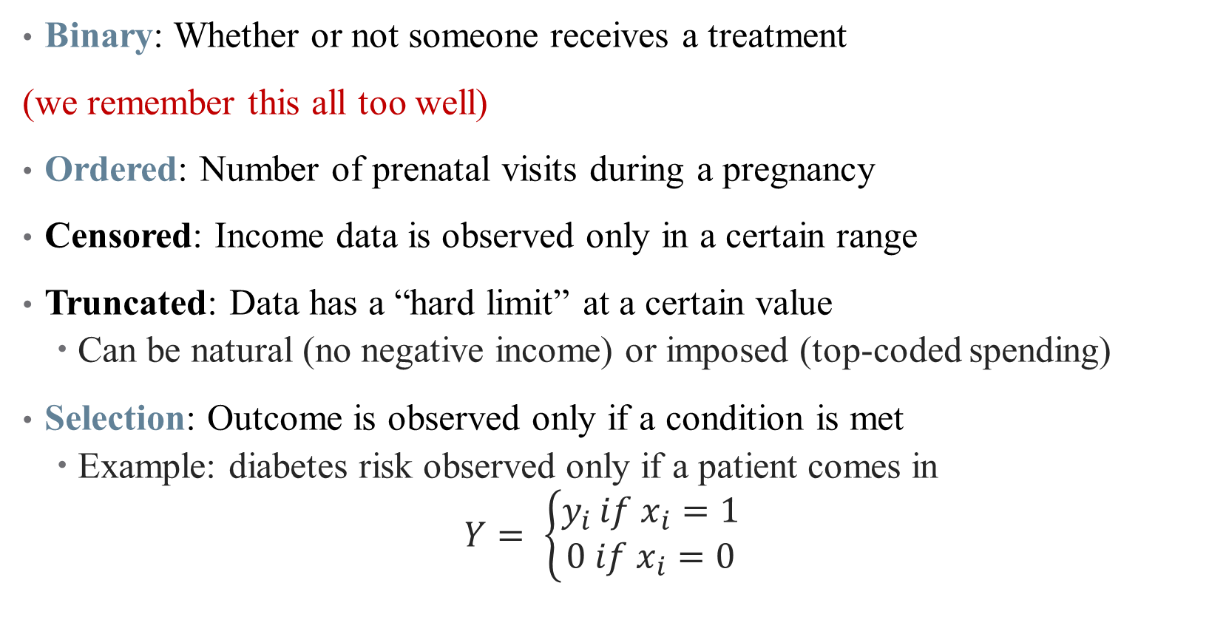
Examples of Limited Dependent Variables
Binary: Whether or not someone receives a treatment
(we remember this all too well)
Ordered: Number of prenatal visits during a pregnancy
Censored: Income data is observed only in a certain range
Truncated: Data has a “hard limit” at a certain value
Can be natural (no negative income) or imposed (top-coded spending)
Selection: Outcome is observed only if a condition is met
Example: diabetes risk observed only if a patient comes in
$$Y= \left\{\begin{aligned}y_{i }if x_{i}=1 \\ 0 if x_{i}=0\end{aligned}\right.$$
Notes:
Last time we did binary, today we’re doing ordered and selection

Slide 6
Count Data: Poisson Regression

Slide 7
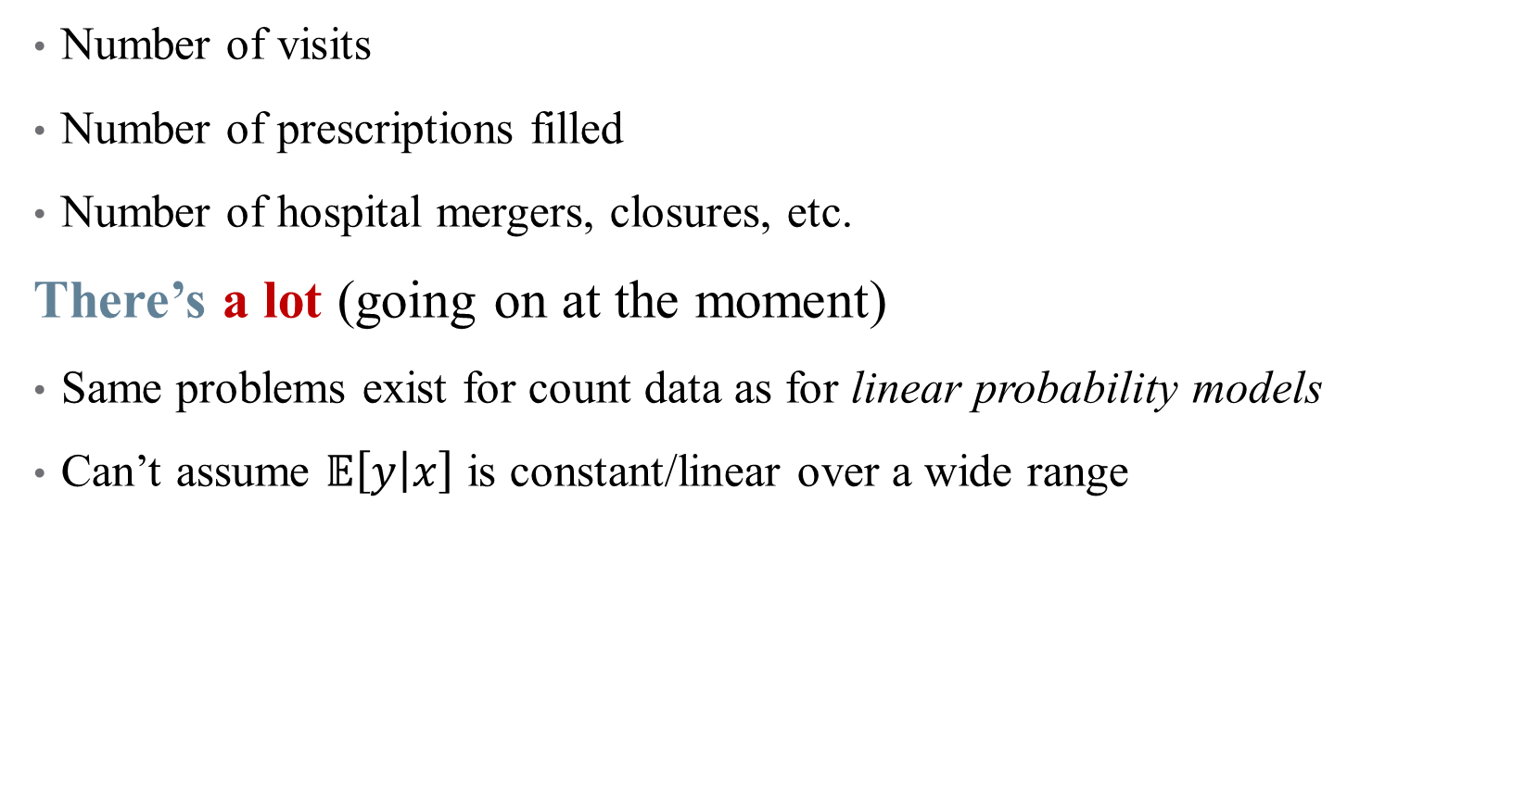
Examples of Count Data in Health Policy
Number of visits
Number of prescriptions filled
Number of hospital mergers, closures, etc.
There’s a lot (going on at the moment)
Same problems exist for count data as for linear probability models
Can’t assume $𝔼\left[y | x\right]$ is constant/linear over a wide range

Slide 8
Examples of Count Data in Health Policy
Number of visits
Number of prescriptions filled
Number of hospital mergers, closures, etc.
There’s a lot
When an event is relatively rare (counts are small), data tend to be far from normally distributed
We use Poisson regression to handle this

Slide 9
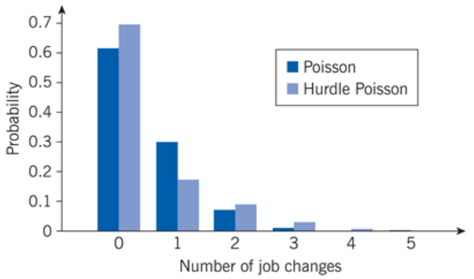
Examples of Count Data: Job Changes
Count to ten, take it in
Notes:
Main feature: low counts, far from normal. Hurdle Poisson takes into account the fact that we may not see people with 0 job changes in our data. We’ll get to that.

Slide 10

The Poisson Distribution
We can use GLM again to handle this non-normality
We just need a link function that approximates shape of data
Notes:
Draw Poisson distribution over data in class

Slide 11
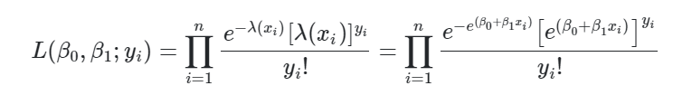
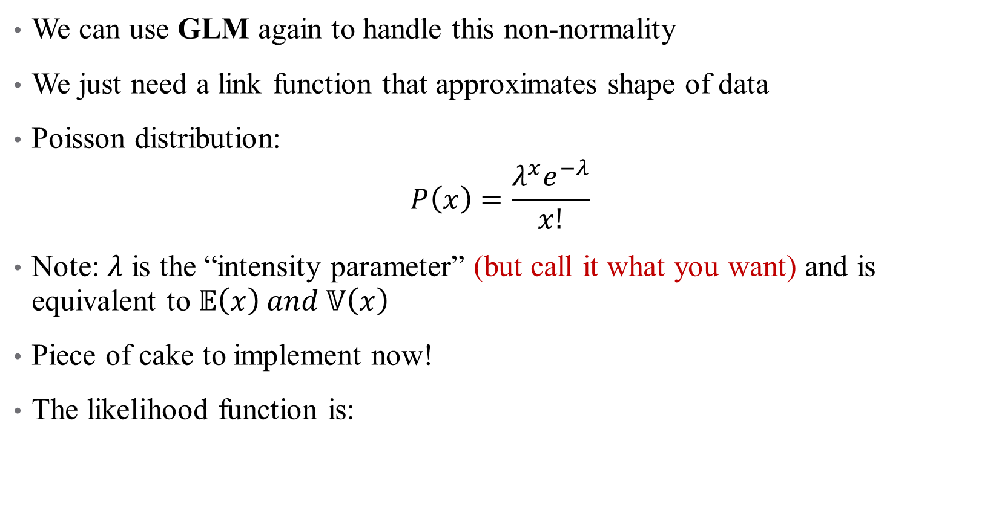
The Poisson Distribution
We can use GLM again to handle this non-normality
We just need a link function that approximates shape of data
Poisson distribution:
$$P\left(x\right)=\frac{λ^{x}e^{−λ}}{x!}$$
Note: $λ$ is the “intensity parameter” (but call it what you want) and is equivalent to $𝔼\left(x\right) and 𝕍\left(x\right)$
Piece of cake to implement now!
The likelihood function is:
Notes:
Likelihood function looks weird, but remember we just need a linear index function (our regression, bottom right of equation) and a pdf as our link function.

Slide 12
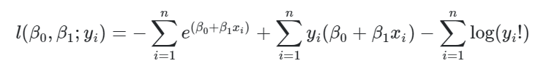

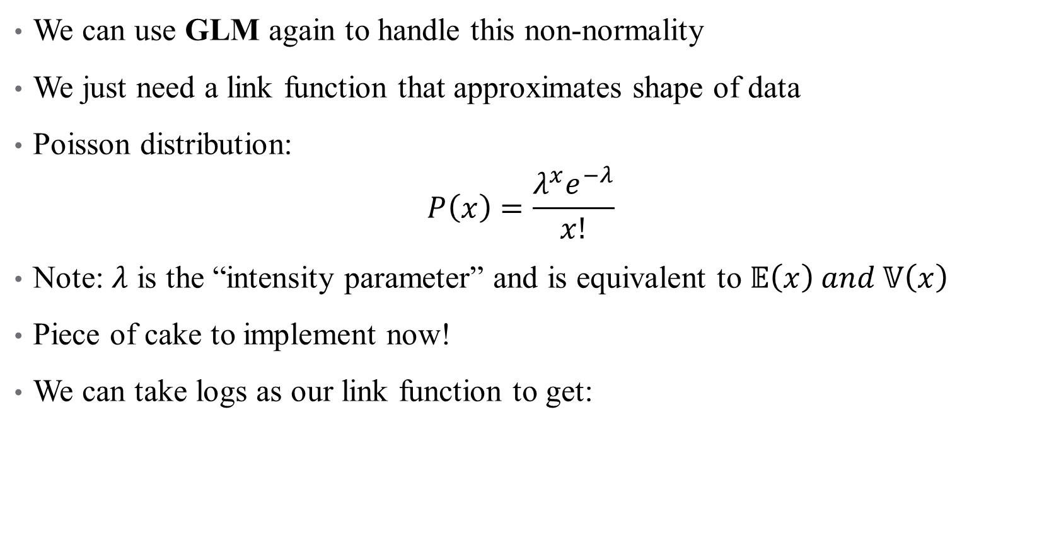
The Poisson Distribution
We can use GLM again to handle this non-normality
We just need a link function that approximates shape of data
Poisson distribution:
$$P\left(x\right)=\frac{λ^{x}e^{−λ}}{x!}$$
Note: $λ$ is the “intensity parameter” and is equivalent to $𝔼\left(x\right) and 𝕍\left(x\right)$
Piece of cake to implement now!
We can take logs as our link function to get:
Notes:
Can drop the last term in maximization – doesn’t matter because it doesn’t depend on beta.

Slide 13
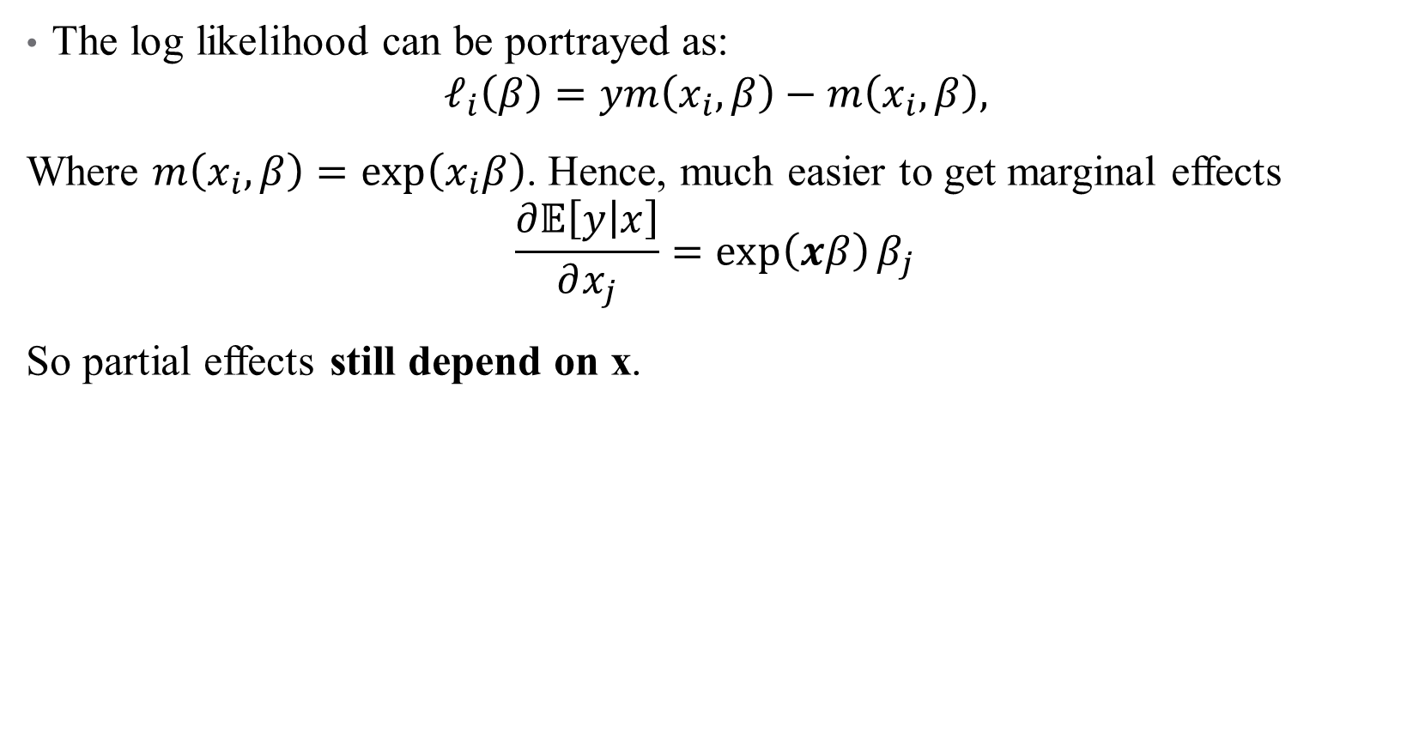
Poisson Regressions in Practice: Interpretation
The log likelihood can be portrayed as:
$$ℓ_{i}\left(β\right)=ym\left(x_{i},β\right)−m\left(x_{i},β\right),$$
Where $m\left(x_{i},β\right)=\exp\left(x_{i}β\right)$. Hence, much easier to get marginal effects
$$\frac{∂𝔼\left[y | x\right]}{∂x_{j}}=\exp\left(xβ\right)β_{j}$$
So partial effects still depend on x.
Notes:
Now I know you were thinking “I knew you were trouble”

Slide 14
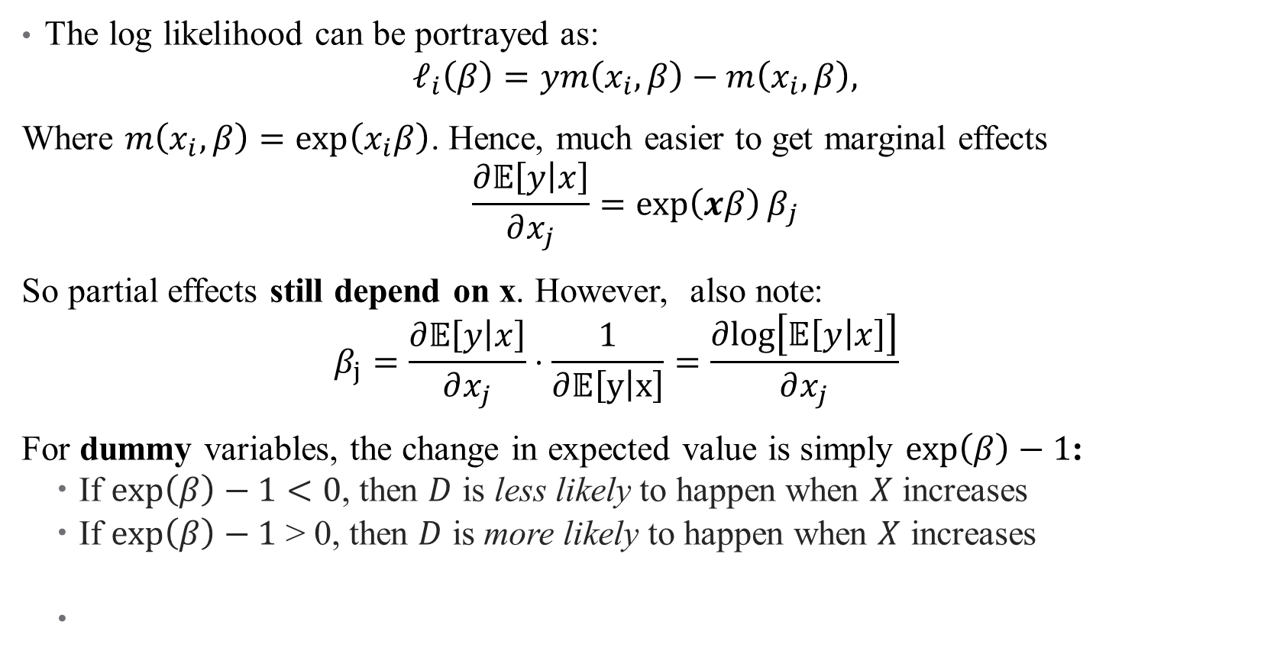
Poisson Regressions in Practice: Interpretation
The log likelihood can be portrayed as:
$$ℓ_{i}\left(β\right)=ym\left(x_{i},β\right)−m\left(x_{i},β\right),$$
Where $m\left(x_{i},β\right)=\exp\left(x_{i}β\right)$. Hence, much easier to get marginal effects
$$\frac{∂𝔼\left[y | x\right]}{∂x_{j}}=\exp\left(xβ\right)β_{j}$$
So partial effects still depend on x. However, also note:
$$β_{j}=\frac{∂𝔼\left[y | x\right]}{∂x_{j}}⋅\frac{1}{∂𝔼\left[y | x\right]}=\frac{∂log\left[𝔼\left[y | x\right]\right]}{∂x_{j}}{}$$
For dummy variables, the change in expected value is simply $\exp\left(β\right)−1$:
If $\exp\left(β\right)−1<0$, then $D$ is less likely to happen when $X$ increases
If $\exp\left(β\right)−1$ > 0, then $D$ is more likely to happen when $X$ increases
Notes:
You’re using the Poisson pdf here, and getting a semi-elasticity! So 100 beta_j is approximately the percentage change. Here it really is percent increase, not percentage points (because this is essentially a log transform)!

Slide 15

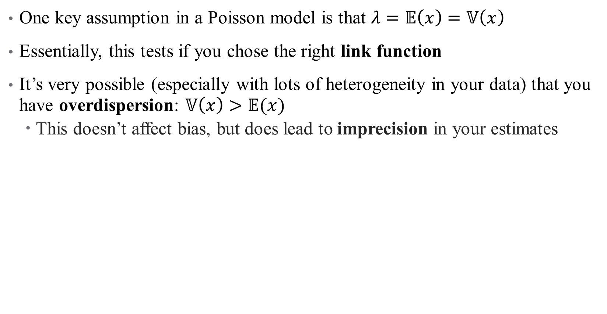
Poisson Regressions in Practice: Dispersion
One key assumption in a Poisson model is that $λ=𝔼\left(x\right)=𝕍\left(x\right)$
Essentially, this tests if you chose the right link function
It’s very possible (especially with lots of heterogeneity in your data) that you have overdispersion: $𝕍\left(x\right)>𝔼(x)$
This doesn’t affect bias, but does lead to imprecision in your estimates
Notes:
Overdispersion is likely since we know e(x) is small – otherwise, why would be doing poisson in the first place?

Slide 16
Poisson Regressions in Practice: Advantages
Useful for count data, but also for any case with nonnegative data:
Don’t need additional assumptions about conditional mean (log-transformed data)
Natural way to deal with zeros
Avoids inconsistency when using log-transformed + heteroskedasticity
Not as computationally intensive anymore (ppmlhdfe in Stata, glm in R)
Can report marginal effects, or use initial coefficients as approximate percentage changes (similar to a log model -- I’ve never been anywhere close as you)

Slide 17

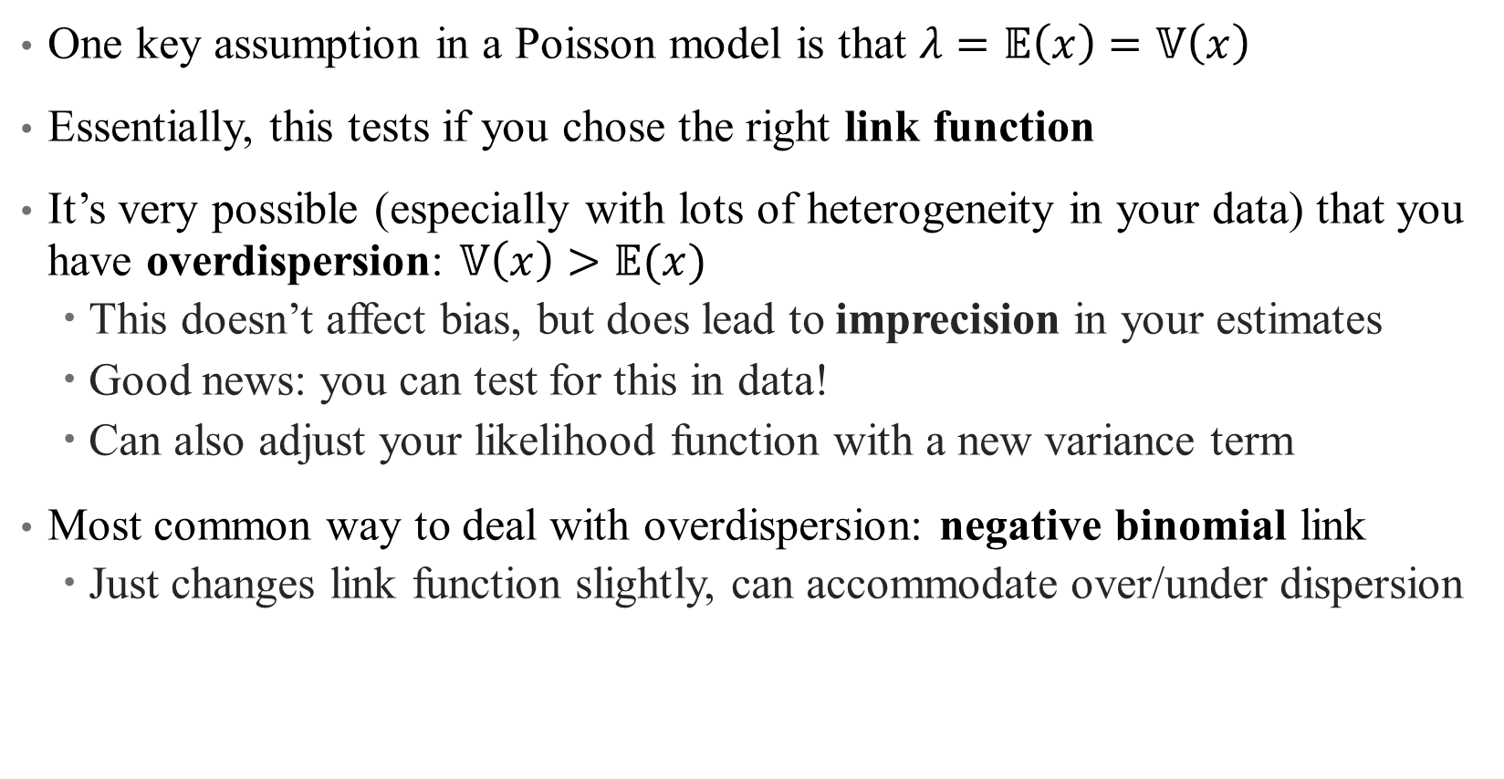
Poisson Regressions in Practice: Dispersion
One key assumption in a Poisson model is that $λ=𝔼\left(x\right)=𝕍\left(x\right)$
Essentially, this tests if you chose the right link function
It’s very possible (especially with lots of heterogeneity in your data) that you have overdispersion: $𝕍\left(x\right)>𝔼(x)$
This doesn’t affect bias, but does lead to imprecision in your estimates
Good news: you can test for this in data!
Can also adjust your likelihood function with a new variance term
Most common way to deal with overdispersion: negative binomial link
Just changes link function slightly, can accommodate over/under dispersion
Notes:
Negative binomial adds an additional variance parameter. Doesn’t really matter unless you are doing a complicated model and need to reduce parameters. LWYMD

Slide 18
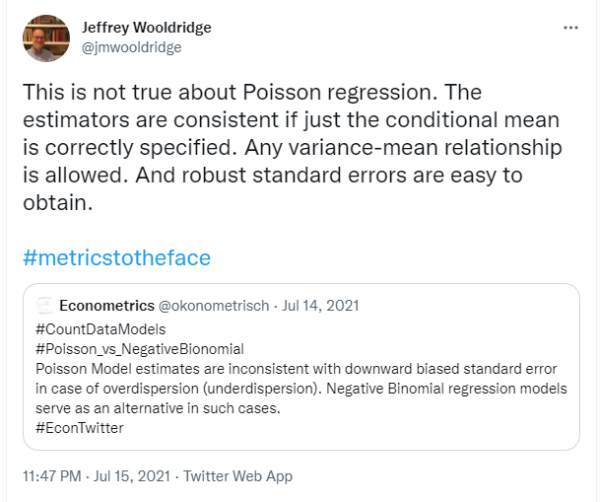

Poisson Regressions in Practice: Dispersion
Shake it off!
Notes:
It’s not as big a deal as yo umight have heard. Negative binomial adds an additional variance parameter. Doesn’t really matter unless you are doing a complicated model and need to reduce parameters.

Slide 19
Example: How do hospital closures affect access?
Context: Between 1997 and 2002, Los Angeles County lost roughly 10% of its initial 131 hospitals
9 other “general acute care” hospitals also closed
Notes:
Note: is table 1 a helpful descriptive? How can it be better? Main mechanism is distance! Possible that it could be beneficial if you close low-quality hospitals (average quality increases). They are assuming that hospital closures are exogenous to patients (good assumption or not?)

Slide 20

Example: How do hospital closures affect access?
Context: Between 1997 and 2002, Los Angeles County lost roughly 10% of its initial 131 hospitals
9 other “general acute care” hospitals also closed
Contribution: assessing the impact of hospital closures on:
Perceived access to care
Health care utilization
Health outcomes
What do we think? Valid? Interesting?
What’s the main mechanism? What’s the hypothesis/hypotheses?
Notes:
Note: is table 1 a helpful descriptive? How can it be better? Main mechanism is distance! Possible that it could be beneficial if you close low-quality hospitals (average quality increases). They are assuming that hospital closures are exogenous to patients (good assumption or not?)

Slide 21
Example: How do hospital closures affect access?
Context: Between 1997 and 2002, Los Angeles County lost roughly 10% of its initial 131 hospitals
9 other “general acute care” hospitals also closed
Contribution: “assessing the impact of hospital closures on perceived access to care, health care utilization and health outcomes”
What do we think? Valid? Interesting?
What’s the main mechanism? What’s the hypothesis/hypotheses?
Data: household surveys + administrative zip code level mortality data
How useful is this? What would be better?
Notes:
Note: is table 1 a helpful descriptive? How can it be better? Main mechanism is distance! Possible that it could be beneficial if you close low-quality hospitals (average quality increases). The data seems usefu lin the sense hat it allows to separate out two things: where people are getting care, nd where care might be most valuable (AMI)

Slide 22
Example: How do hospital closures affect access?
Context: Between 1997 and 2002, Los Angeles County lost roughly 10% of its initial 131 hospitals
9 other “general acute care” hospitals also closed
Contribution: “assessing the impact of hospital closures on perceived access to care, health care utilization and health outcomes”
What do we think? Valid? Interesting?
What’s the main mechanism? What’s the hypothesis/hypotheses?
Data: household surveys + administrative zip code level mortality data
How useful is this? What would be better?
Methods: What exogeneity assumption are they resting on?
Do they have a control group? Who?
I know that it’s delicate…
Notes:
They are assuming that hospital closures are exogenous to patients (good assumption or not – areas might be very different?) Control group is those in areas without closures.

Slide 23
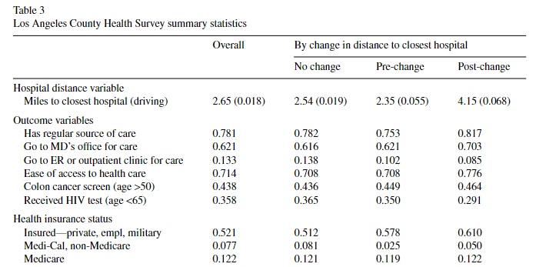
Data: What story are we telling here?
New to town with a made up name in the angels’ city chasing fortune and fame
Notes:
How do we interpret these results?

Slide 24
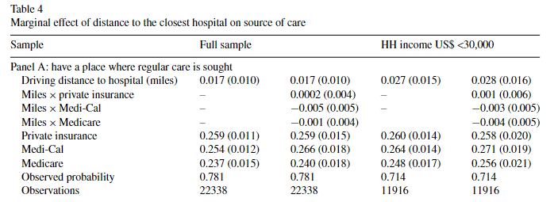
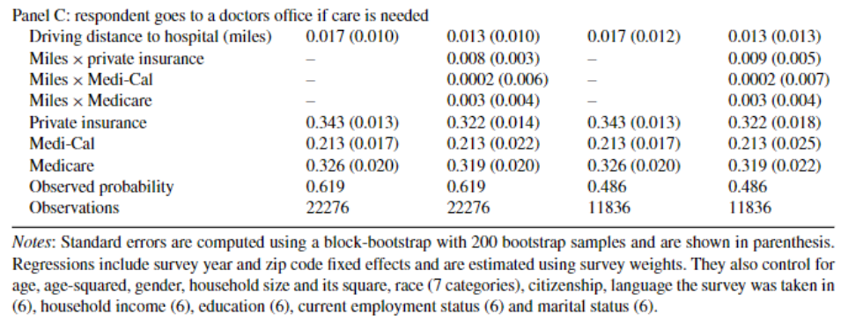
Results: Linear Probability Models
Notes:
How do we interpret these results? (Review; how would these change if we used logit/probit)?

Slide 25
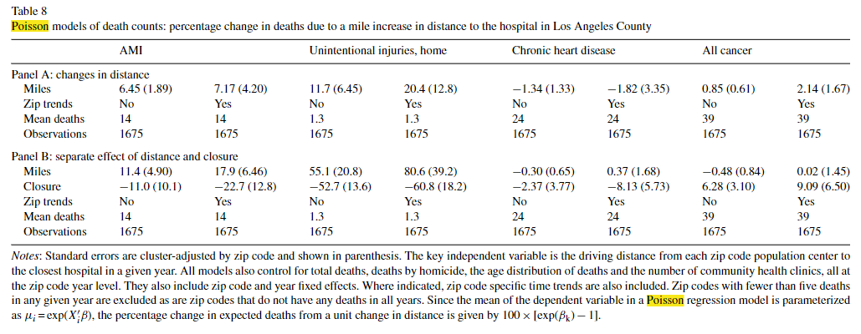

Poisson results: How do hospital closures affect access?
Notes:
How do we interpret these results? Notice the title is helpful here – plus look at that note! But we have very small death counts here, and are the results significant? Not really talking about significance here or in the paper.

Slide 26
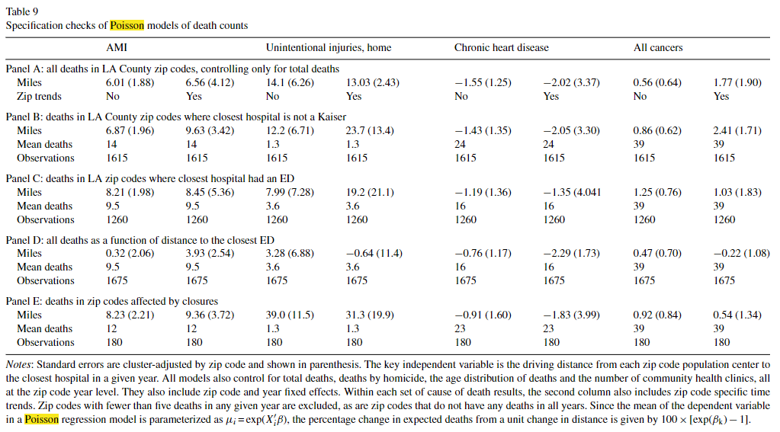
Poisson results: How do hospital closures affect access?
Notes:
How do we interpret these results? Specification/robustness checks: what concerns are we addressing here? Mostly checking the mechanisms – are mortality results driven by lack of ER access. Panel D is the funkiest. What is panel E attempting to do (take into account differences in treated vs. control group)

Slide 27
Mini Referee Report
What do you think about this paper? Any concerns? Anything clever?
Do you believe the results? I almost do…
Notes:
Some of my concerns – what are these negative trends from the closure? Reporting error? I don’t like the data. Would have liked to see some figures.

Slide 28
Identification and Alternate Approaches
(How You Get the Girl)
Notes:
Note – this tends to be very econ-heavy/specific. I think it’s valuable though, as other fields don’t always give the same thought to these issues. So I’m highlighting it here.
Some useful sources:
https://davidcard.berkeley.edu/lectures/woytinsky.pdf

Slide 29
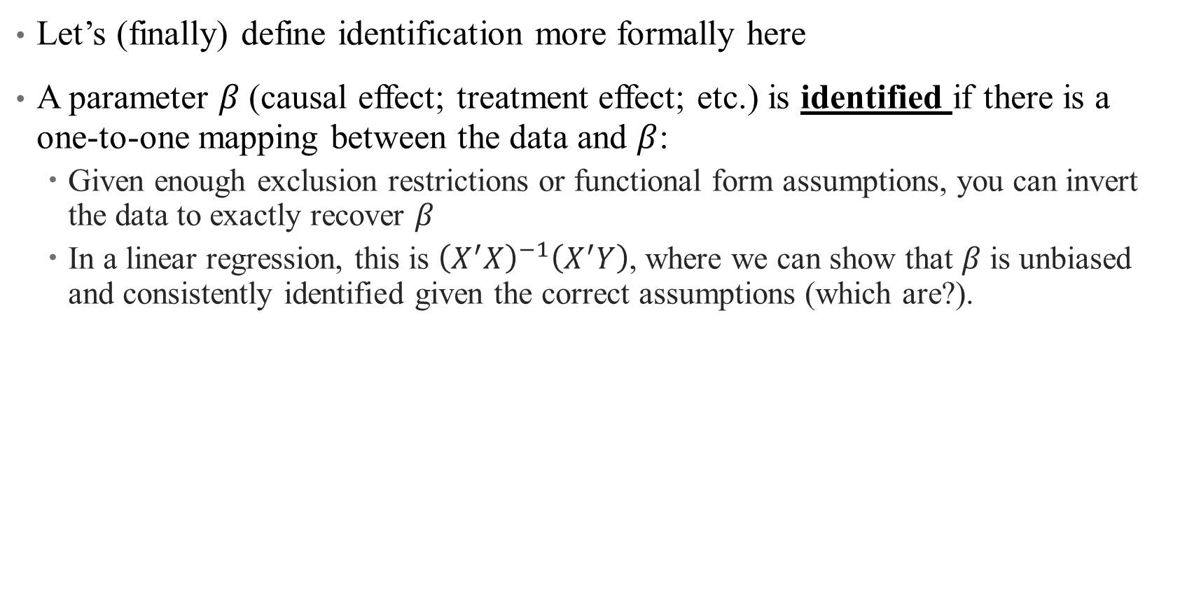
Identification: A definition
Let’s (finally) define identification more formally here
A parameter $β$(causal effect; treatment effect; etc.) is identified if there is a one-to-one mapping between the data and $β$:
Given enough exclusion restrictions or functional form assumptions, you can invert the data to exactly recover $β$
In a linear regression, this is ${\left(X^{′}X\right)}^{−1}\left(X^{′}Y\right)$, where we can show that $β$ is unbiased and consistently identified given the correct assumptions (which are?).
Notes:
What does this mean intuitively? Consider the opposite: When we say something is “unidentified”, we mean that there are multiple stories (multiple truths?) that the data could be telling, and we can’t tell them apart. When something is identified, the story is certain.

Slide 30
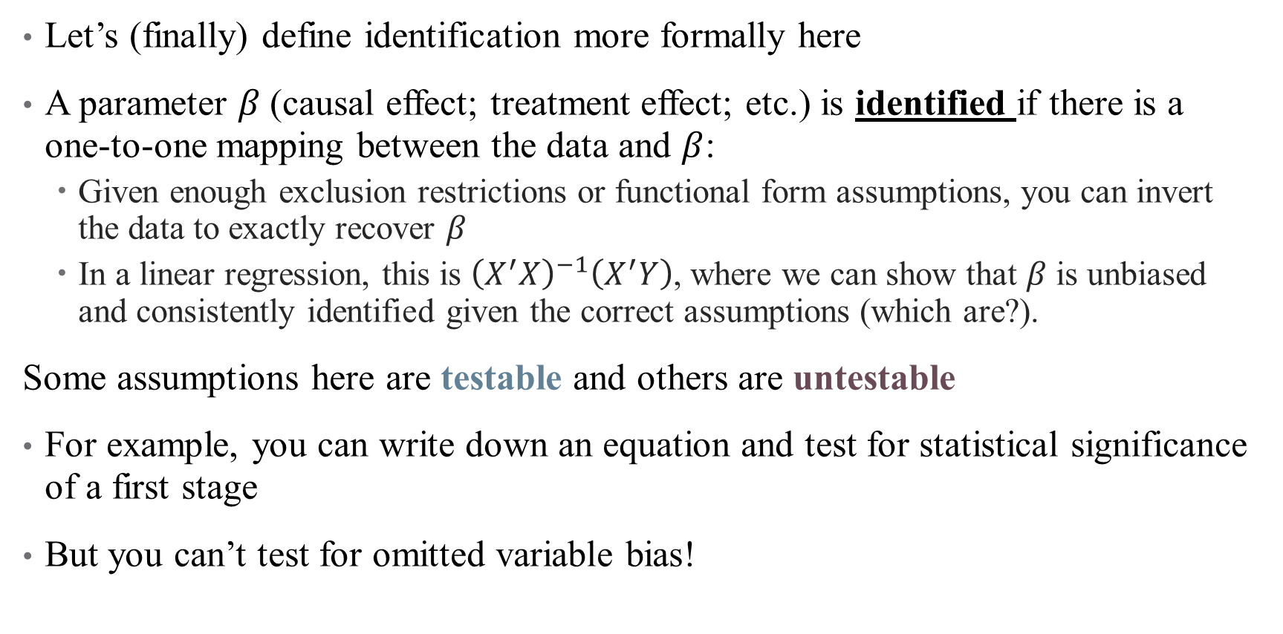
Identification: A definition
Let’s (finally) define identification more formally here
A parameter $β$(causal effect; treatment effect; etc.) is identified if there is a one-to-one mapping between the data and $β$:
Given enough exclusion restrictions or functional form assumptions, you can invert the data to exactly recover $β$
In a linear regression, this is ${\left(X^{′}X\right)}^{−1}\left(X^{′}Y\right)$, where we can show that $β$ is unbiased and consistently identified given the correct assumptions (which are?).
Some assumptions here are testable and others are untestable
For example, you can write down an equation and test for statistical significance of a first stage
But you can’t test for omitted variable bias!

Slide 31

Who’s afraid of little old me?

Slide 32

Who’s afraid of little old me?
Well you should be

Slide 33
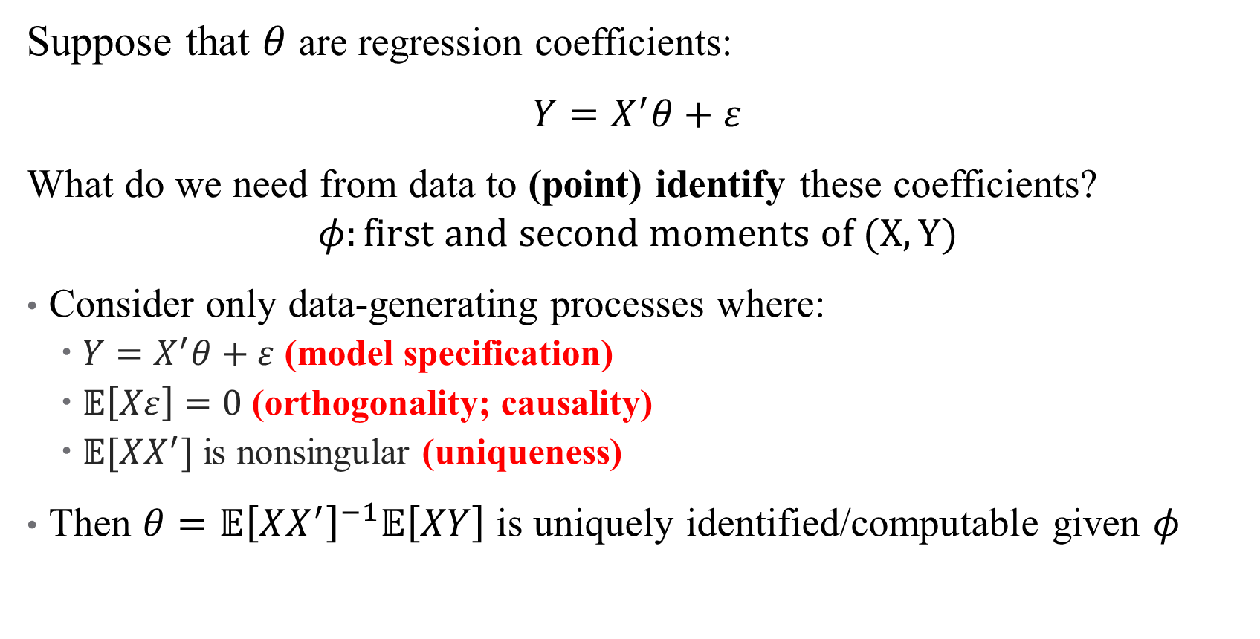
Example: Linear Regression
Let’s begin again…
Suppose that $θ$ are regression coefficients:
$Y=X^{′}θ+ε$
What do we need from data to (point) identify these coefficients?
$$φ:first and second moments of (X,Y)$$
Consider only data-generating processes where:
$Y=X^{′}θ+ε$ (model specification)
$𝔼\left[Xε\right]=0$ (orthogonality; causality)
$𝔼[XX^{′}]$ is nonsingular (uniqueness)
Then $θ=𝔼{\left[XX^{′}\right]}^{−1}𝔼\left[XY\right]$ is uniquely identified/computable given $φ$
Notes:
Method of moments (alternatives are to specify a likelihood function)

Slide 34
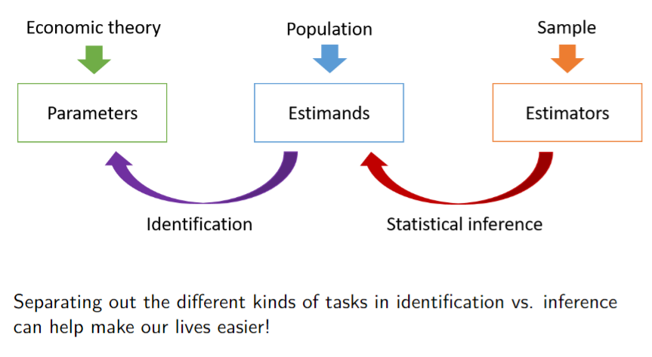
Identification: A definition
Notes:
See Peter Hull’s class on design-based inference for more useful notes.

Slide 35
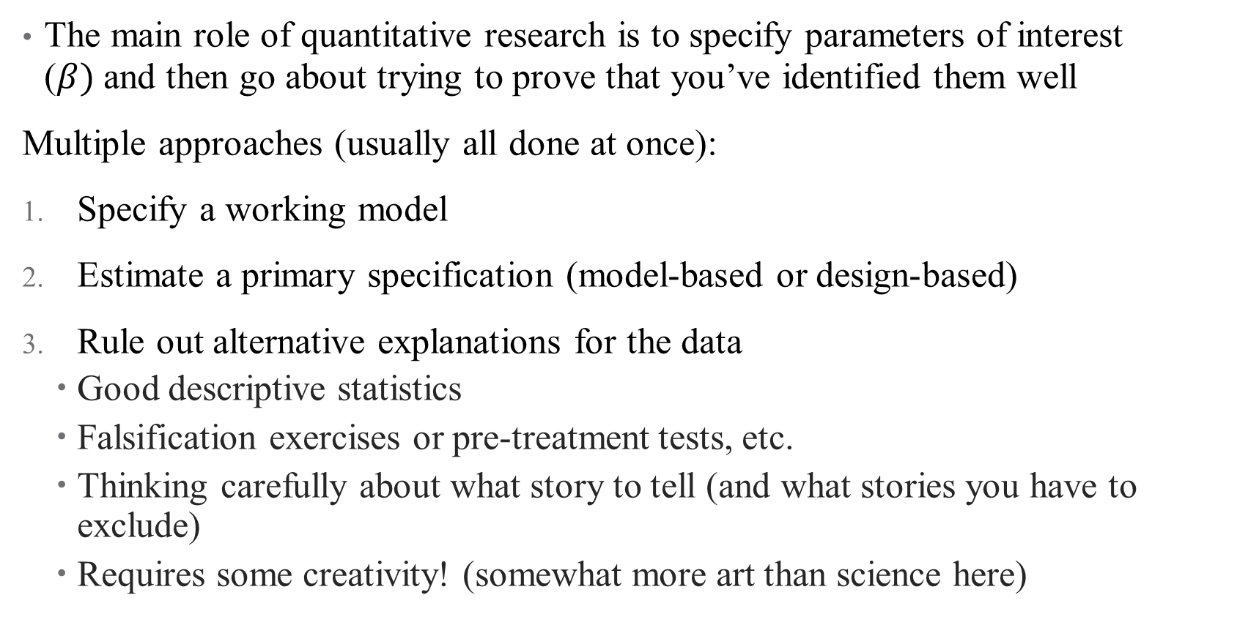
The Identification Police
The main role of quantitative research is to specify parameters of interest ($β)$and then go about trying to prove that you’ve identified them well
Multiple approaches (usually all done at once):
Specify a working model
Estimate a primary specification (model-based or design-based)
Rule out alternative explanations for the data
Good descriptive statistics
Falsification exercises or pre-treatment tests, etc.
Thinking carefully about what story to tell (and what stories you have to exclude)
Requires some creativity! (somewhat more art than science here)

Slide 36

The Identification Police
The main role of quantitative research is to specify parameters of interest ($β)$and then go about trying to prove that you’ve identified them well
Multiple approaches (usually all done at once):
Specify a working model
Estimate a primary specification (model-based or design-based)
Rule out alternative explanations for the data
Good descriptive statistics
Falsification exercises or pre-treatment tests, etc.
Thinking carefully about what story to tell (and what stories you have to exclude)
Requires some creativity! (somewhat more art than science here)
Notes:
This is where a lot of work goes! You come up with the question, execute the methods well, communicate the results well – but this is the part where the story comes together.

Slide 37
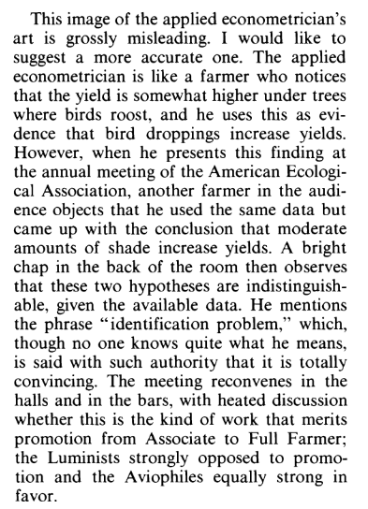
The Identification Police
Notes:
An example from “Let’s take the con out of econometrics” Leamer (1983). When we say something is “unidentified”, we mean that there are multiple stories (multiple truths?) that the data could be telling, and we can’t tell them apart.
More interesting materials here: https://github.com/paulgp/applied-methods-phd.

Slide 38
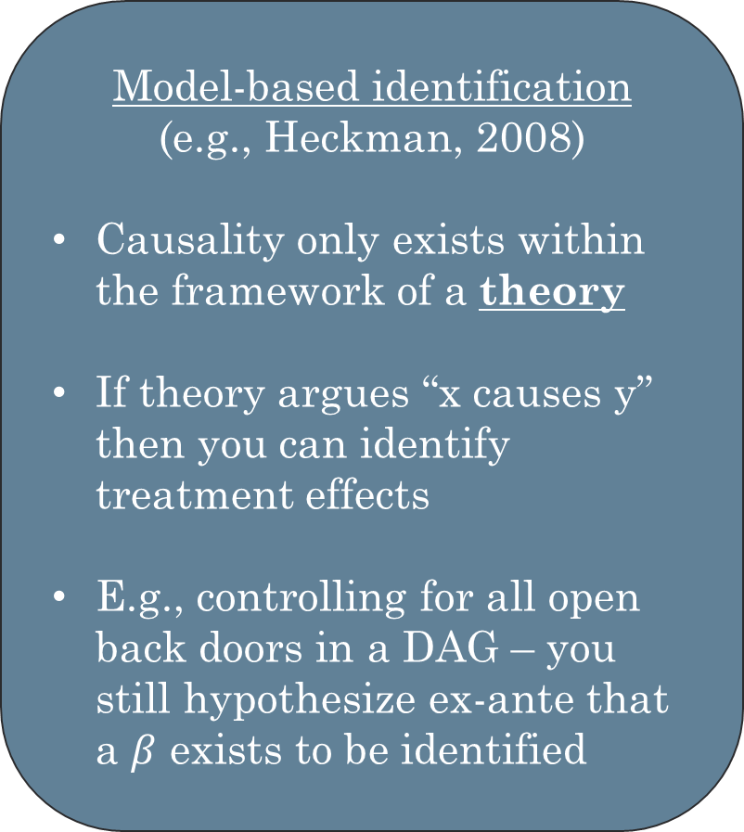
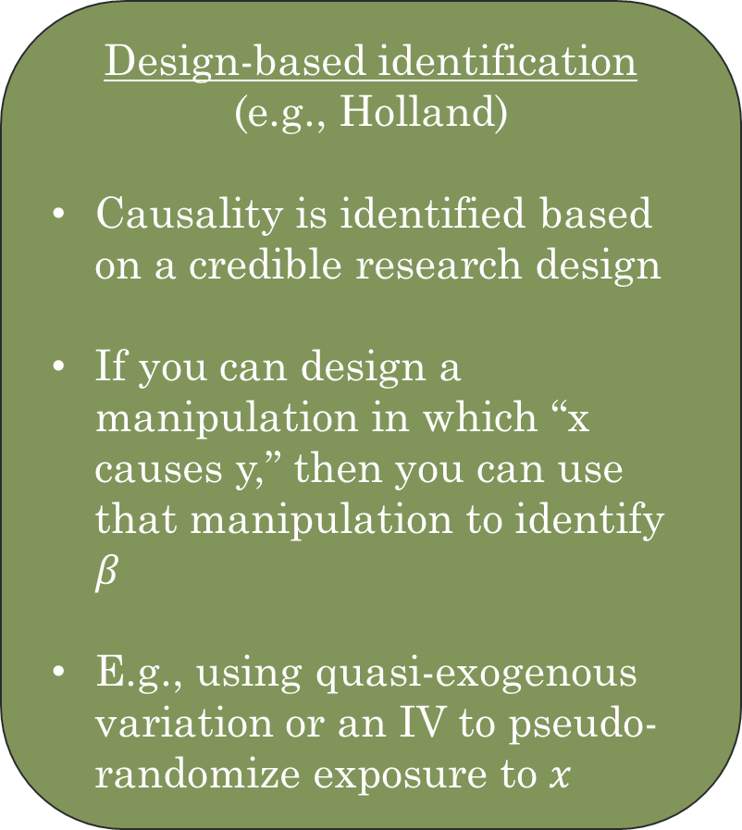
Approaches to Identification (a review)
Model-based identification
(e.g., Heckman, 2008)
Causality only exists within the framework of a theory
If theory argues “x causes y” then you can identify treatment effects
E.g., controlling for all open back doors in a DAG – you still hypothesize ex-ante that a $β$ exists to be identified
Design-based identification
(e.g., Holland)
Causality is identified based on a credible research design
If you can design a manipulation in which “x causes y,” then you can use that manipulation to identify $β$
E.g., using quasi-exogenous variation or an IV to pseudo-randomize exposure to $x$
Notes:
What do we need to be able to say something is (point) identified?

Slide 39

Approaches to Identification (a review)
Model-based identification
(e.g., Heckman, 2008)
Causality only exists within the framework of a theory
If theory argues “x causes y” then you can identify treatment effects
E.g., controlling for all open back doors in a DAG – you still hypothesize ex-ante that a $β$ exists to be identified
Design-based identification
(e.g., Holland)
Causality is identified based on a credible research design
If you can design a manipulation in which “x causes y,” then you can use that manipulation to identify $β$
E.g., using quasi-exogenous variation or an IV to pseudo-randomize exposure to $x$
Notes:
Both can be…

Slide 40
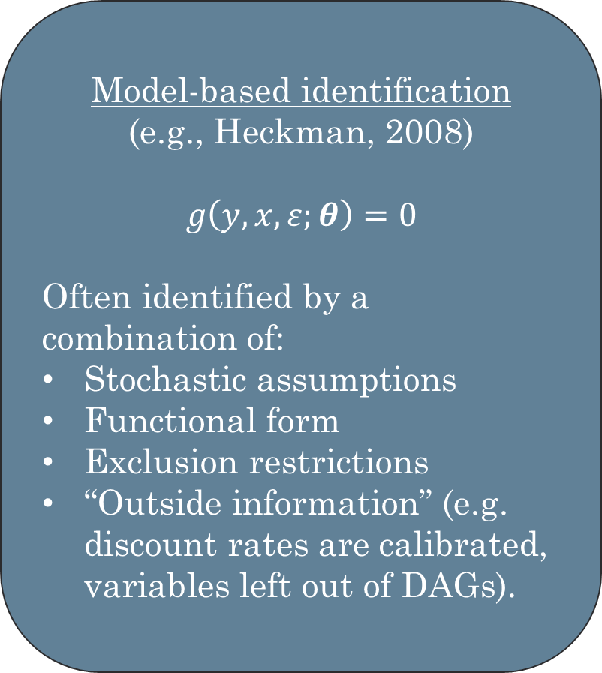
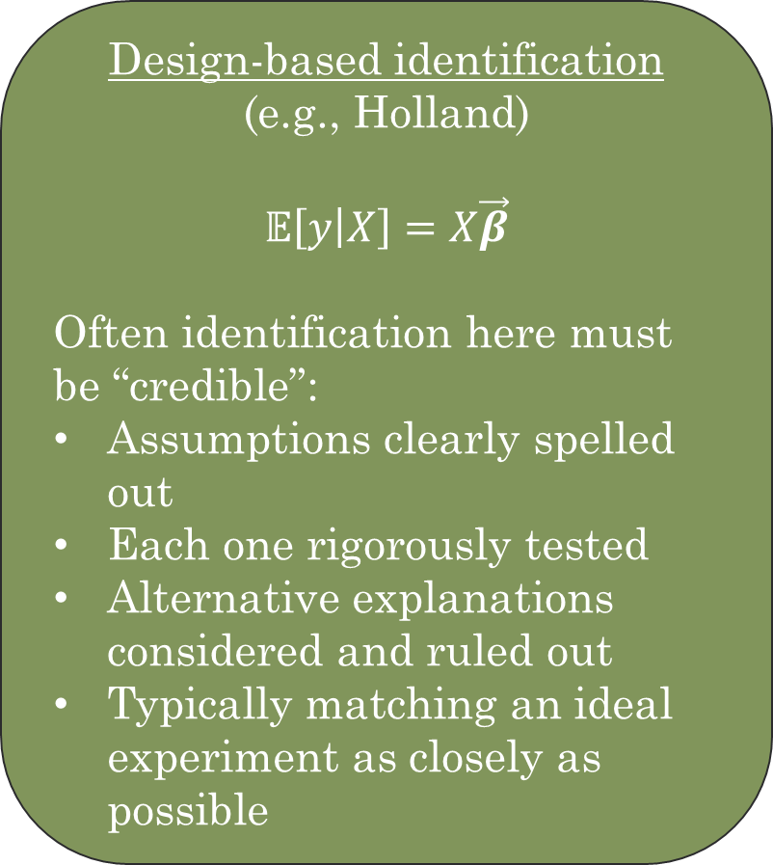
Approaches to Identification (a review)
Model-based identification
(e.g., Heckman, 2008)
$$g\left(y,x,ε;θ\right)=0$$
Often identified by a combination of:
Stochastic assumptions
Functional form
Exclusion restrictions
“Outside information” (e.g. discount rates are calibrated, variables left out of DAGs).
Design-based identification
(e.g., Holland)
$$𝔼\left[y | X\right]=X\vec{β}$$
Often identification here must be “credible”:
Assumptions clearly spelled out
Each one rigorously tested
Alternative explanations considered and ruled out
Typically matching an ideal experiment as closely as possible
Notes:
Note: theta here is usually very complete. We stipulate a big model (e.g., structural) and then go about trying to do counterfactual/welfare analysis. On the other hand, sometimes design-based stuff gets really into the weeds – we try to model a single response parameter (like the impact of raising minimum wages on employment).

Slide 41
Linking Identification and Models (our invisible strings)
Quantitative studies (economics in particular) always have a “working model”
Framework that specifies:
Agents
Decision variables
Institutional settings
The working model specifies (at least implicitly):
Whose behavior are we modeling?
What are the constraints?
What are endogenous choice vars?
What variables are known/observed? What time horizon, level of aggregation, etc?
Can be a regression equation or even more formal (e.g., structural approaches)
A successful working model causes a “suspension of disbelief”: readers/listeners narrow their focus

Slide 42
Linking Identification and Models
But models aren’t perfect!
Exogenous variables in one working model are often the endogenous outcomes of another model
Example, partial equilibrium responses vs. general equilibrium (how are institutions developed?)
Likewise, unobserved tastes/abilities etc. can be endogenous outcomes (peer effects, etc.)
Wide debate about what is a legitimate working model

Slide 43
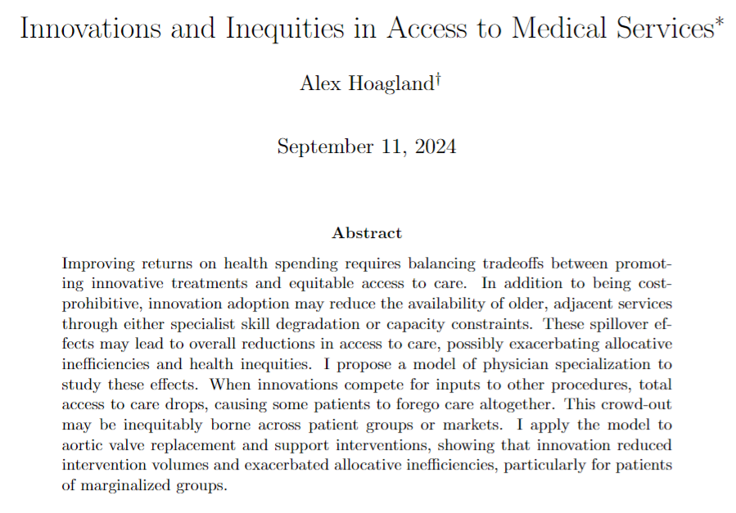
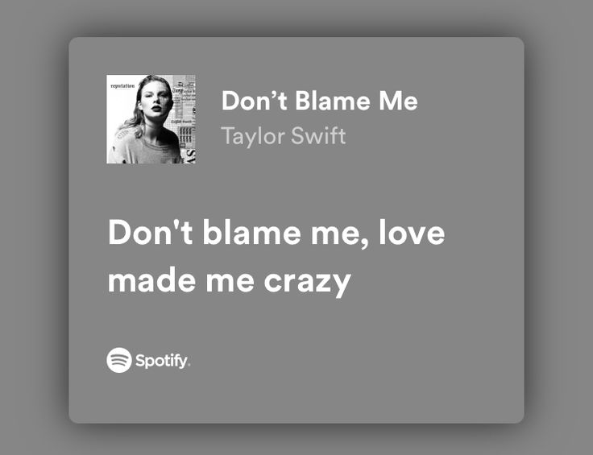
An Example (using a short paper I know pretty well)
Notes:
What’s the main question here? What am I trying to argue?

Slide 44
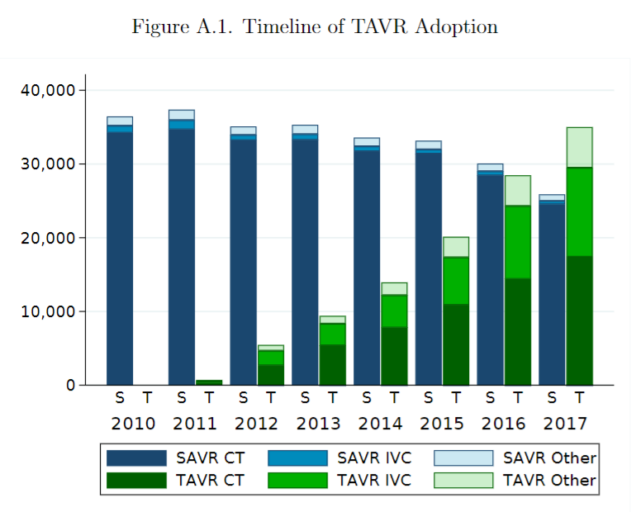
An Example (using a short paper I know pretty well)
Notes:
Setting here (don’t get too in the weeds). Main question: is there scope for an innovation to affect availability of other, non-innovated procedures? How might that affect patient groups differently?

Slide 45
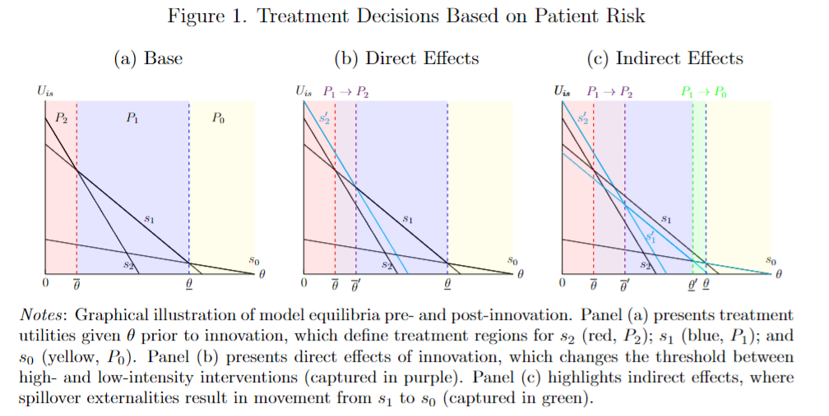
An Example (using a short paper I know pretty well)
Notes:
The intuition of the working model can be summed up here. What things am I bringing into the model? What things am I taking as given or leaving out?
Ultimately, what kind of parameter am I trying to identify here? Is this model-based or design-based?
What is the right regression equation here then? (Effect of TAVR’s adoption on total surgical volumes)

Slide 46
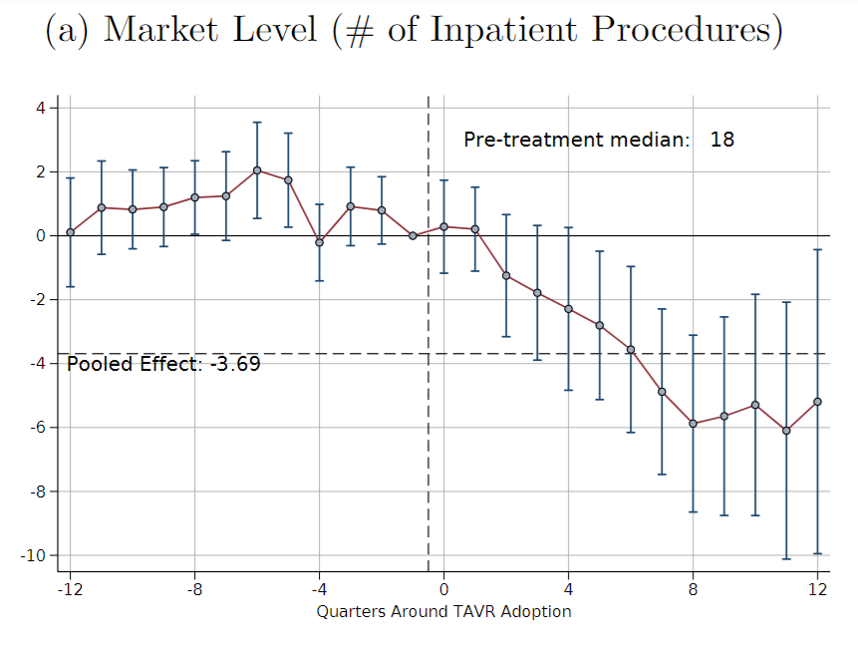
An Example (using a short paper I know pretty well)
Long story short…
Notes:
Main estimator here – what is the treatment effect of interest? How would I know if this is identified?
Gold standard: what is the “ideal experiment” I’d be trying to replicate here?

Slide 47
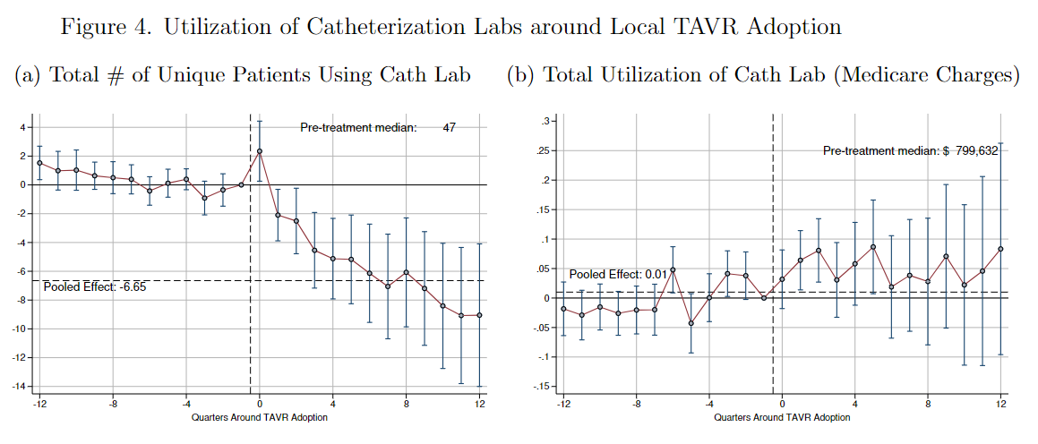
An Example (using a short paper I know pretty well)
But tell me why!
Notes:
Now we think about “credible identification” – there is a lot of this in the paper! Two things to highlight:
Testing mechanisms (even when they seem obvious)
Ruling out alternative explanations

Slide 48
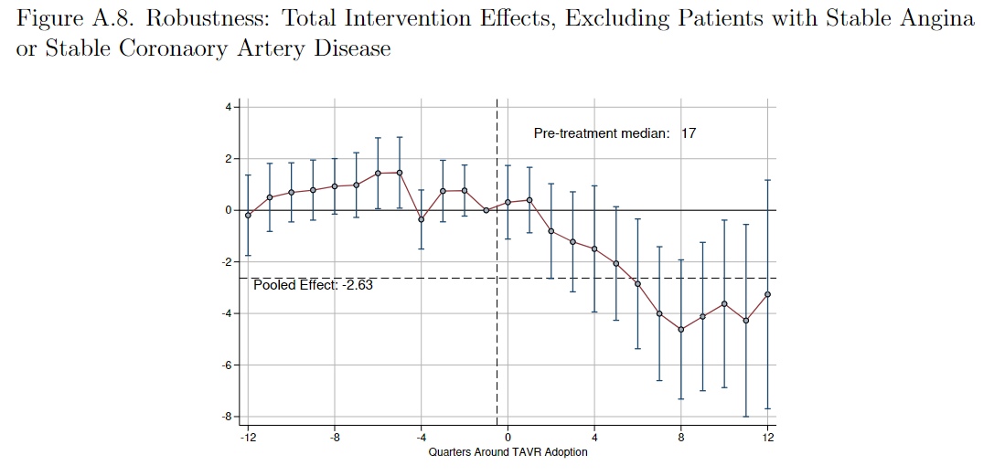
An Example (using a short paper I know pretty well)
Notes:
Now we think about “credible identification” – there is a lot of this in the paper! Two things to highlight:
Testing mechanisms (even when they seem obvious)
Ruling out alternative explanations

Slide 49

Notes:
Make it here for a break?

Slide 50
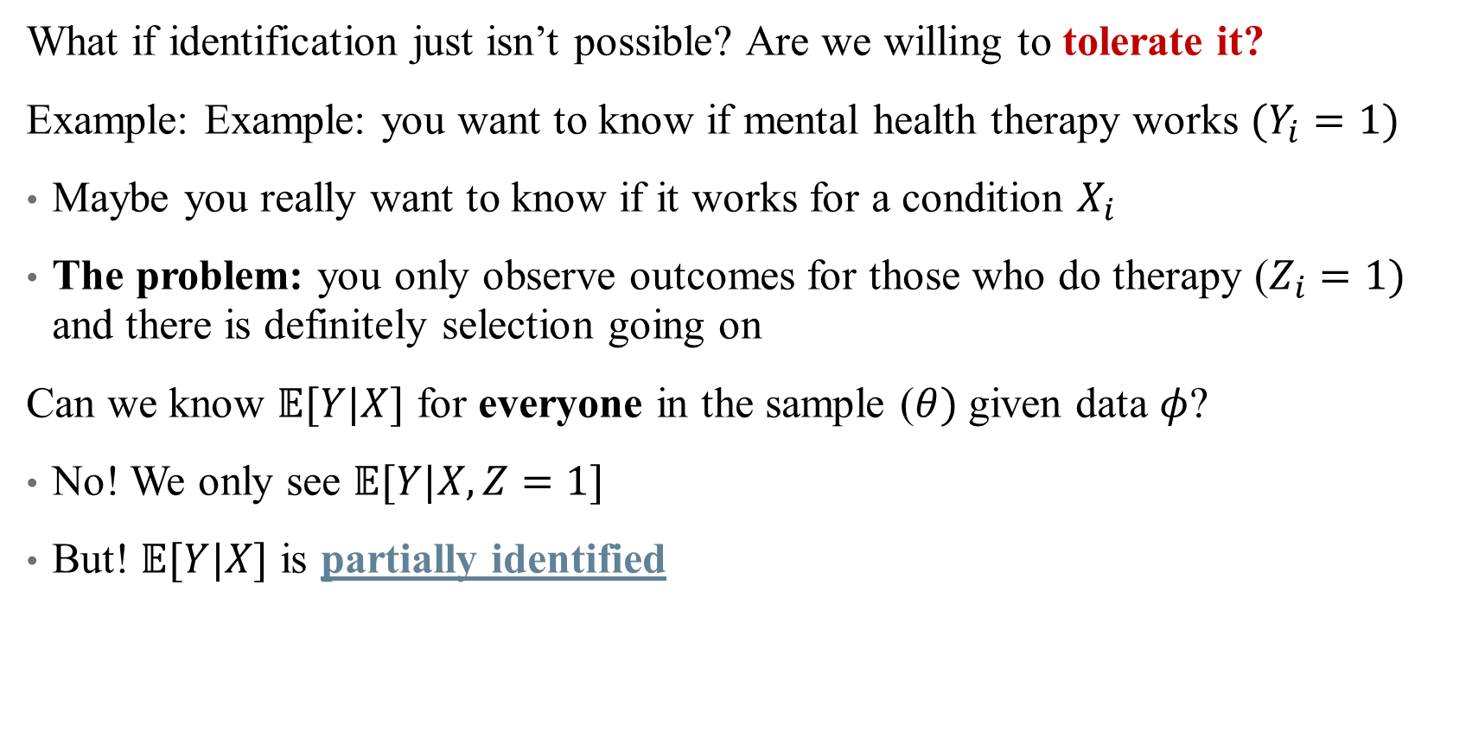
Alternative Approaches to Identification
What if identification just isn’t possible? Are we willing to tolerate it?
Example: Example: you want to know if mental health therapy works $(Y_{i}=1)$
Maybe you really want to know if it works for a condition $X_{i}$
The problem: you only observe outcomes for those who do therapy ($Z_{i}=1)$ and there is definitely selection going on
Can we know $𝔼[Y|X]$ for everyone in the sample ($θ)$given data $φ$?
No! We only see $𝔼[Y|X,Z=1]$
But! $𝔼[Y|X]$ is partially identified
Notes:
What other options do we have? (Partial identification) . See Guido Imbens slides on this material (2008). This example adapted from Paul Goldsmith-Pinkham’s slides here: https://github.com/paulgp/applied-methods-phd/blob/main/lectures/26_partial_identification.pdf.

Slide 51
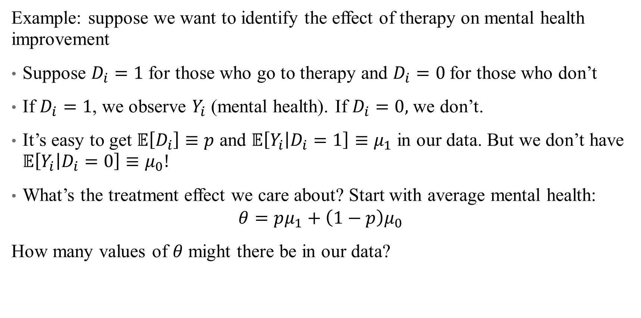
Alternative Approaches to Identification
Example: suppose we want to identify the effect of therapy on mental health improvement
Suppose $D_{i}=1$ for those who go to therapy and $D_{i}=0$for those who don’t
If $D_{i}=1$, we observe $Y_{i}$ (mental health). If $D_{i}=0,$we don’t.
It’s easy to get $𝔼\left[D_{i}\right]≡p$ and $𝔼\left[Y_{i} | D_{i}=1\right]≡μ_{1}$ in our data. But we don’t have $𝔼\left[Y_{i} | D_{i}=0\right]≡μ_{0}!$
What’s the treatment effect we care about? Start with average mental health:
$$θ=pμ_{1}+\left(1−p\right)μ_{0}$$
How many values of $θ$ might there be in our data?
Notes:
What other options do we have? (Partial identification)

Slide 52

Partial Identification

Slide 53
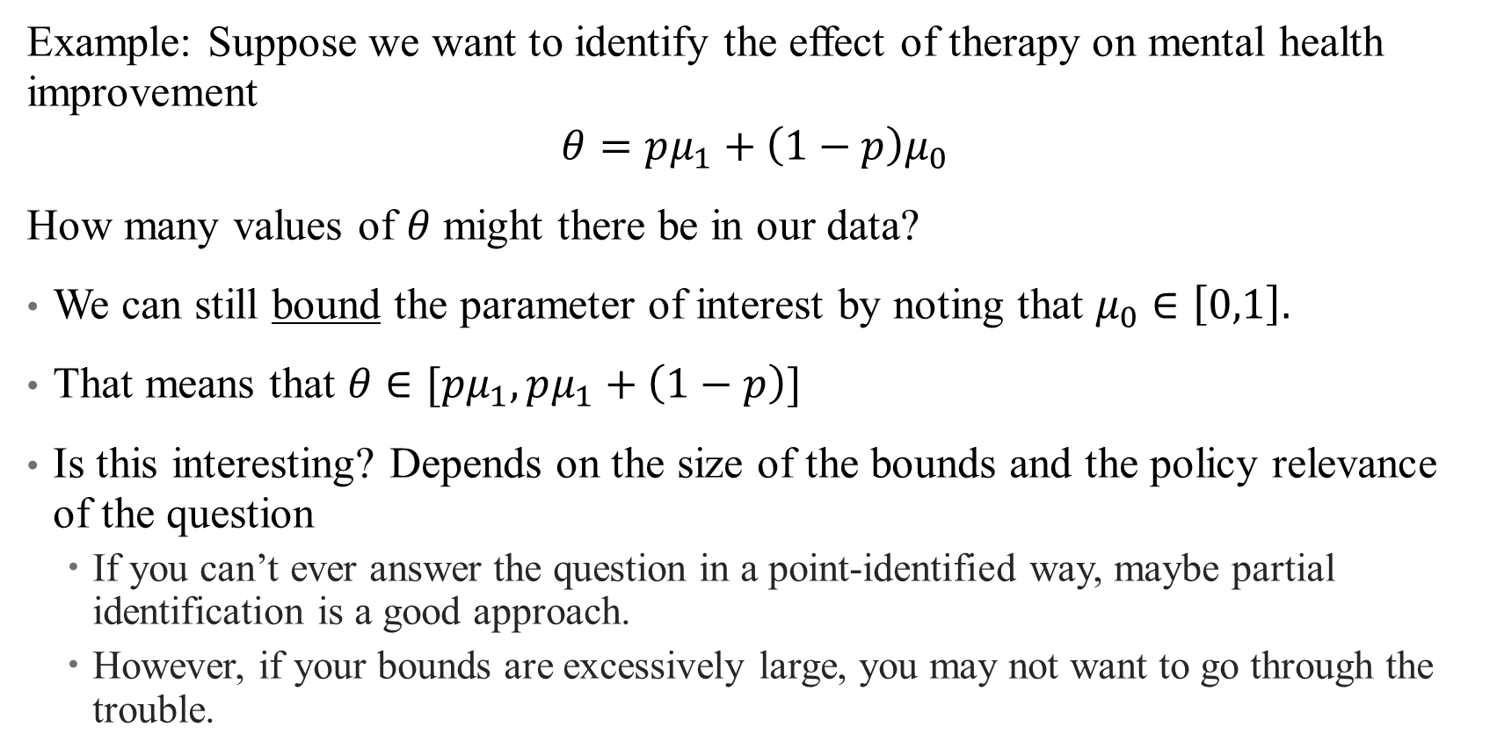
Partial Identification
Example: Suppose we want to identify the effect of therapy on mental health improvement
$$θ=pμ_{1}+\left(1−p\right)μ_{0}$$
How many values of $θ$ might there be in our data?
We can still bound the parameter of interest by noting that $μ_{0}∈\left[0,1\right].$
That means that $θ∈[pμ_{1},pμ_{1}+\left(1−p\right)]$
Is this interesting? Depends on the size of the bounds and the policy relevance of the question
If you can’t ever answer the question in a point-identified way, maybe partial identification is a good approach.
However, if your bounds are excessively large, you may not want to go through the trouble.
Notes:
Work through this with some sample numbers.

Slide 54
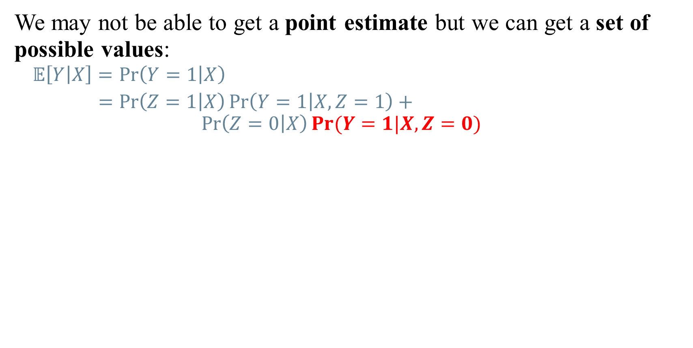
The trick: bounding identification sets
We may not be able to get a point estimate but we can get a set of possible values:
$$𝔼\left[Y | X\right]=\operatorname{Pr}\left(Y=1 | X\right)$$
$=\operatorname{Pr}\left(Z=1 | X\right)\operatorname{Pr}\left(Y=1 | X,Z=1\right)+$ $$\operatorname{Pr}\left(Z=0 | X\right)Pr⁡(Y=1|X,Z=0)$$
Notes:
This example adapted from Paul Goldsmith-Pinkham’s slides here: https://github.com/paulgp/applied-methods-phd/blob/main/lectures/26_partial_identification.pdf.

Slide 55
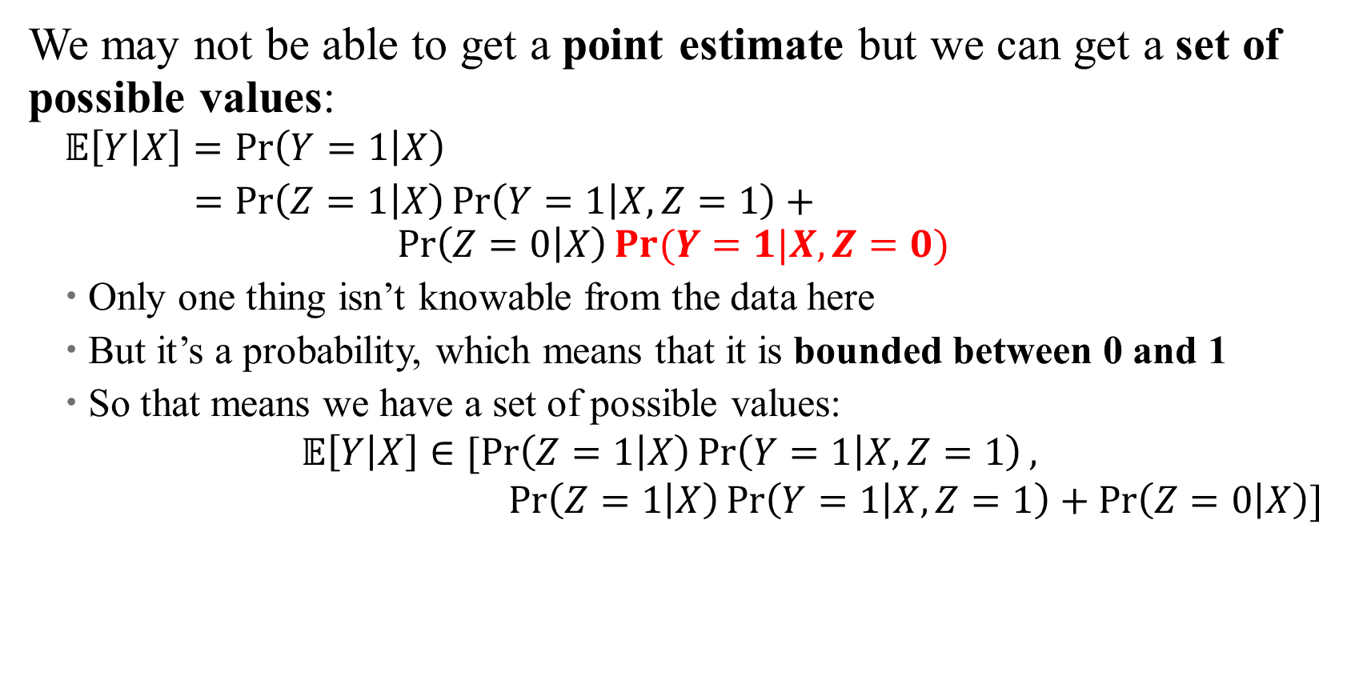
The trick: bounding identification sets
We may not be able to get a point estimate but we can get a set of possible values:
$$𝔼\left[Y | X\right]=\operatorname{Pr}\left(Y=1 | X\right)$$
$=\operatorname{Pr}\left(Z=1 | X\right)\operatorname{Pr}\left(Y=1 | X,Z=1\right)+$ $$\operatorname{Pr}\left(Z=0 | X\right)Pr⁡(Y=1|X,Z=0)$$
Only one thing isn’t knowable from the data here
But it’s a probability, which means that it is bounded between 0 and 1
So that means we have a set of possible values:
$$𝔼\left[Y | X\right]∈[\operatorname{Pr}\left(Z=1 | X\right)\operatorname{Pr}\left(Y=1 | X,Z=1\right),$$ $\operatorname{Pr}\left(Z=1 | X\right)\operatorname{Pr}\left(Y=1 | X,Z=1\right)+\operatorname{Pr}\left(Z=0 | X\right)]$

Slide 56

The trick: bounding identification sets
Partial identification means we don’t have to make (as many) wonky assumptions
Really helpful for things like missing data, selection, etc.!
Tradeoff: giving up a point estimate for a set estimate
But we already had confidence intervals
May still be worth it if identified set is small

Slide 57
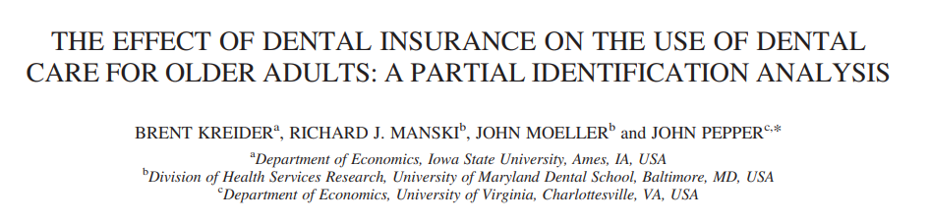
Applied Example: Dental Insurance
Question: what if we just gave people dental insurance?
What’s the main policy concern?
What’s the main data concern? What can’t we identify?
Secondary data concern: mis-reporting of dental insurance in data (HRS)
Notes:
Health economics, 2014. Policy concern is moral hazard (more people will mean more care), and the data problem is that we can’t identify what that new care will look like (the ones with dental insurance now don’t look like the overall population)

Slide 58
Applied Example: Dental Insurance
Question: How does expanding dental insurance affect utilization?
Who “comes out of the woodwork” and induced to use care?
Who is on the margin?
What does utilization look like for this group?
What other research designs does this sound like?
The partial identification here is similar too: monotonicity of selection!
Notes:
IV → identifying LATE for a subgroup

Slide 59
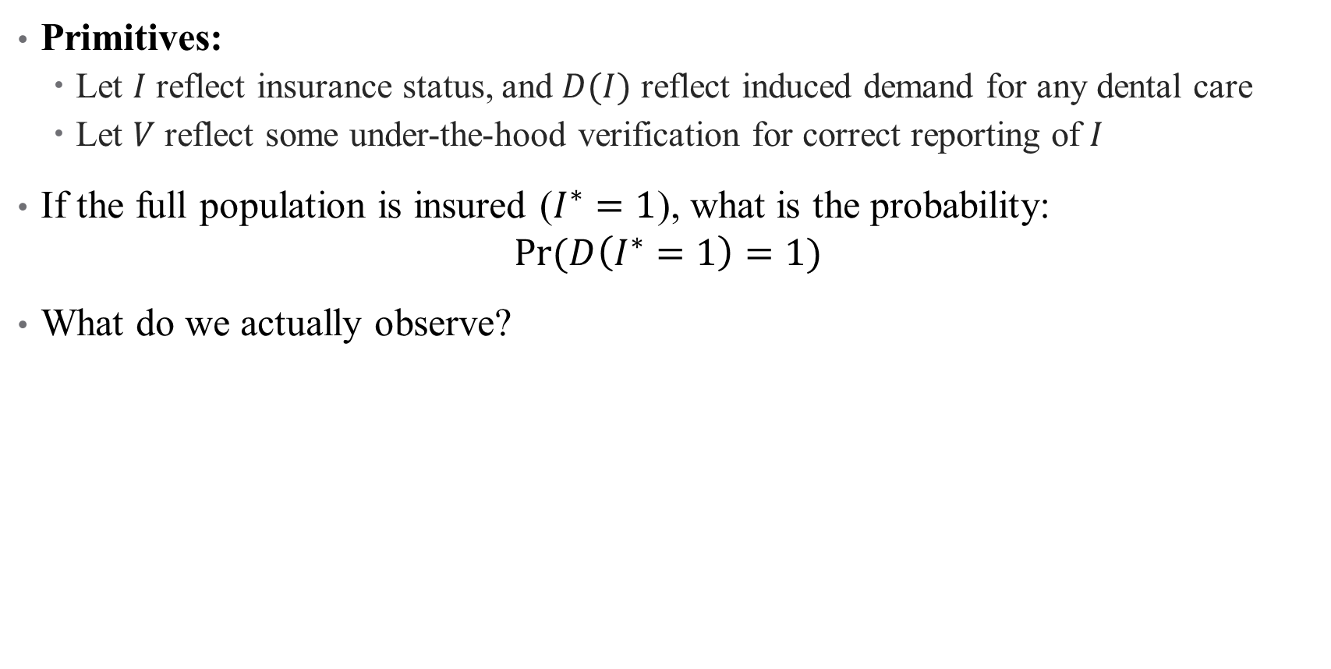
Applied Example: Dental Insurance
Primitives:
Let $I$ reflect insurance status, and $D(I)$ reflect induced demand for any dental care
Let $V$ reflect some under-the-hood verification for correct reporting of $I$
If the full population is insured ($I^{∗}=1$), what is the probability:
$$Pr⁡(D\left(I^{∗}=1\right)=1)$$
What do we actually observe?
Notes:
Note: are we really interested in this thing? What other outcomes might we be interested in? Would those work in a partial identification setting?

Slide 60
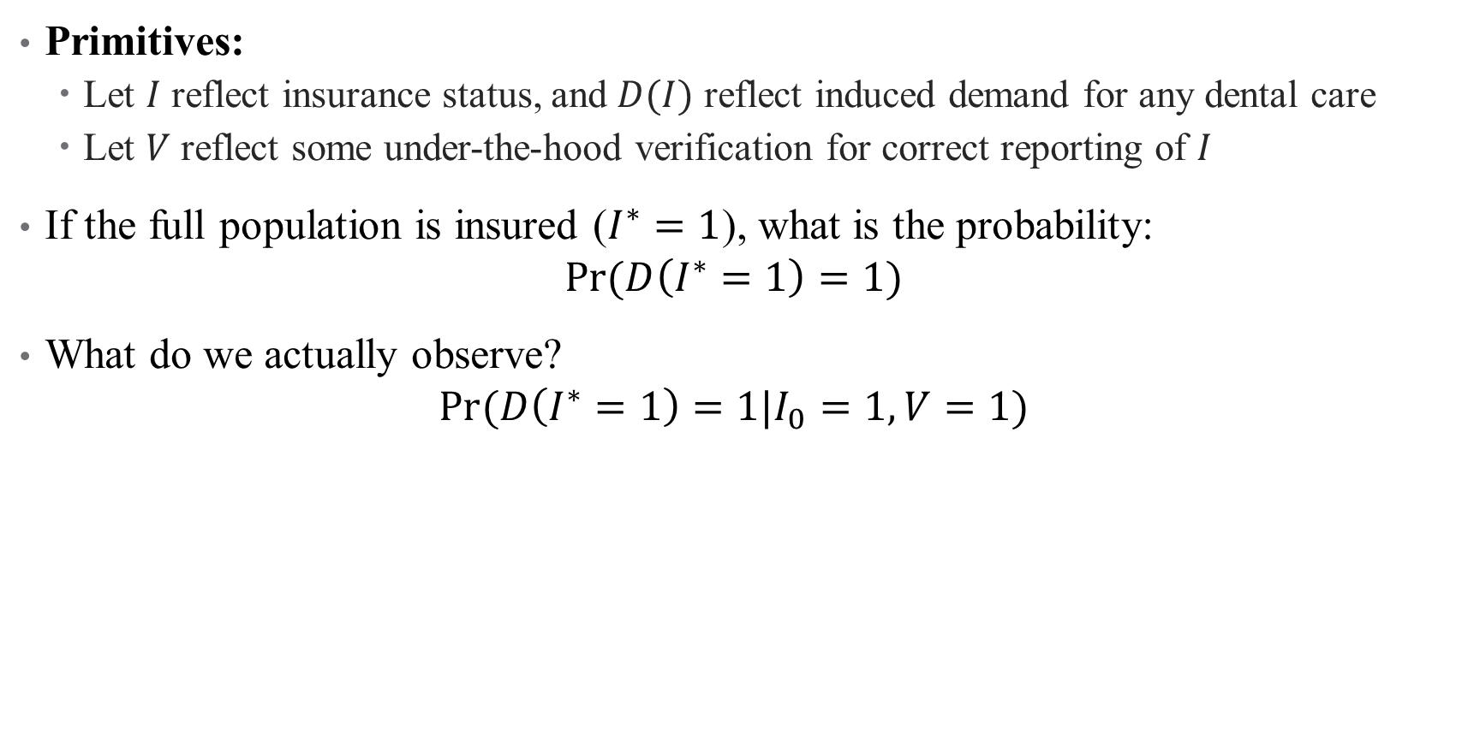
Applied Example: Dental Insurance
Primitives:
Let $I$ reflect insurance status, and $D(I)$ reflect induced demand for any dental care
Let $V$ reflect some under-the-hood verification for correct reporting of $I$
If the full population is insured ($I^{∗}=1$), what is the probability:
$$Pr⁡(D\left(I^{∗}=1\right)=1)$$
What do we actually observe?
$$Pr⁡(D\left(I^{∗}=1\right)=1|I_{0}=1,V=1)$$
Notes:
Note: are we really interested in this thing? What other outcomes might we be interested in? Would those work in a partial identification setting?

Slide 61
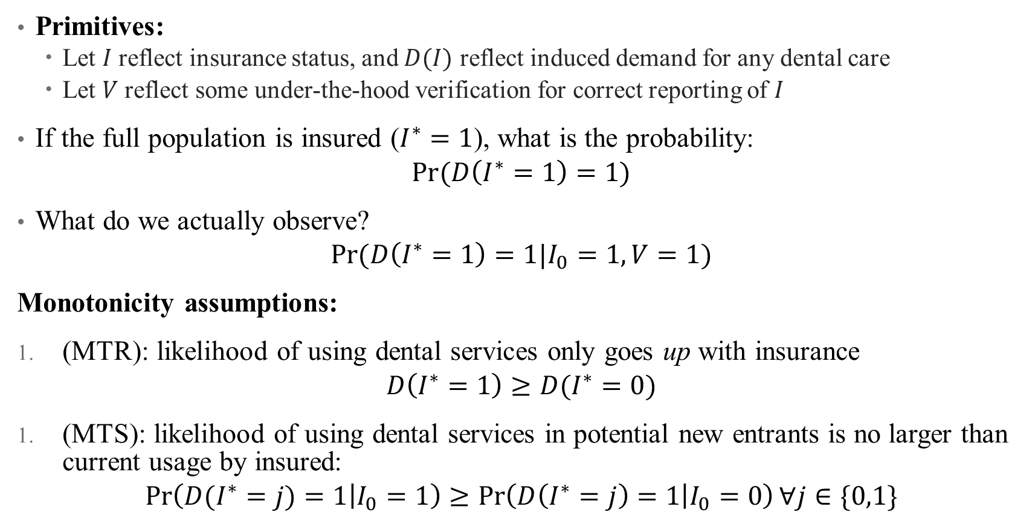
Applied Example: Dental Insurance
Primitives:
Let $I$ reflect insurance status, and $D(I)$ reflect induced demand for any dental care
Let $V$ reflect some under-the-hood verification for correct reporting of $I$
If the full population is insured ($I^{∗}=1$), what is the probability:
$$Pr⁡(D\left(I^{∗}=1\right)=1)$$
What do we actually observe?
$$Pr⁡(D\left(I^{∗}=1\right)=1|I_{0}=1,V=1)$$
Monotonicity assumptions:
(MTR): likelihood of using dental services only goes up with insurance
$$D\left(I^{∗}=1\right)≥D(I^{∗}=0)$$
(MTS): likelihood of using dental services in potential new entrants is no larger than current usage by insured:
$$\operatorname{Pr}\left(D(I^{∗}=j)=1 | I_{0}=1\right)≥\operatorname{Pr}\left(D\left(I^{∗}=j\right)=1 | I_{0}=0\right)∀j∈\{0,1\}$$
Notes:
What do you think about these assumptions? MTR means monotone treatment response and MTS means monotone treatment selection

Slide 62
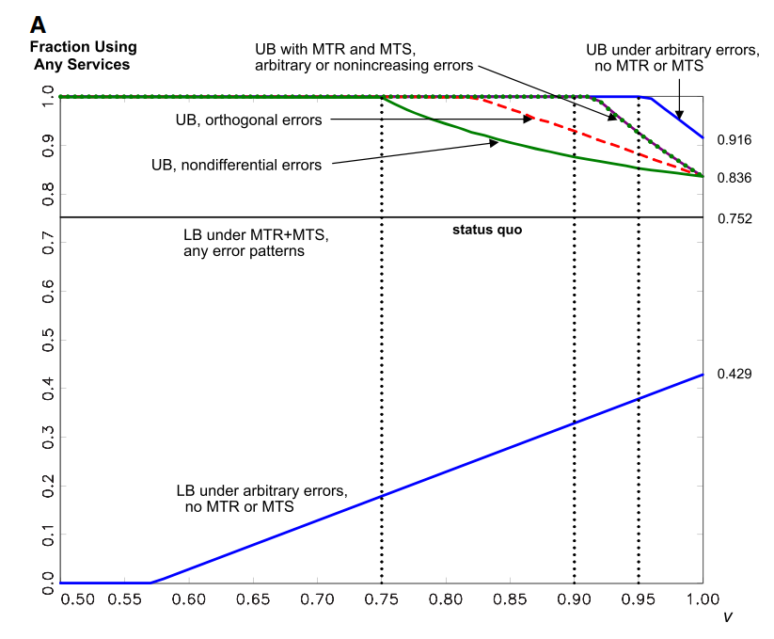
Results
Notes:
Here the outcome is the fraction using any services and the x-axis is the lower bound on correct reporting of dental insurance data. Note large change in LB (we go from 0 to the status quo of 75%, that’s helpful) and the declining upper bounds based on assumptions. More assumptions get you narrower bounds. What do we think about this? (large gaps, still a weird outcome)

Slide 63
Takeaways
Partial identification approaches can reduce assumptions, but come at a cost
Typically easy to compute (no special programming here, just some math)
Easy to state assumptions (typically just “this thing is bounded between 0 and 1”)

Slide 64
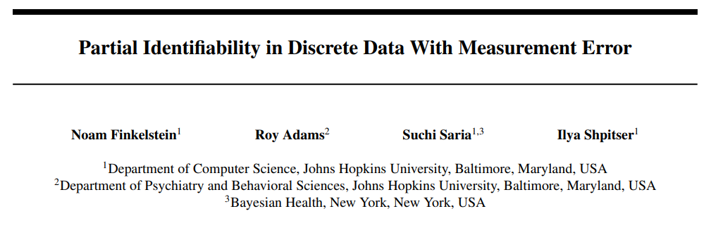
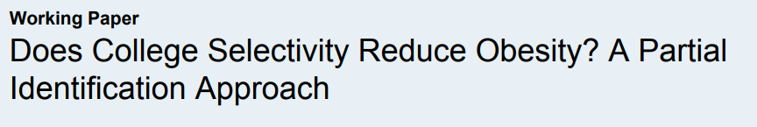
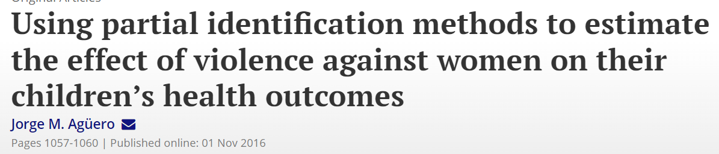
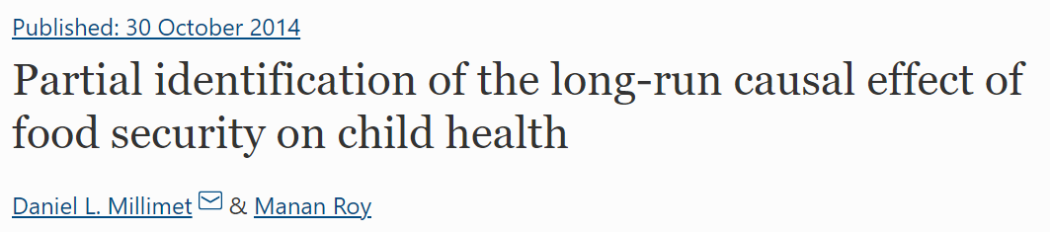

Uses in research

Slide 65

Computational Example: LATEs
One common example – how informative is a LATE?
It’s me – hi!
IV approaches tell us about treatment effects for compliers
Can we get them for other groups?
Notes:
What other groups might we care about?

Slide 66
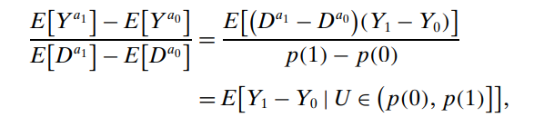
Computational Example: LATEs
One common example – how informative is a LATE?
IV approaches tell us about treatment effects for compliers
Can we get them for other groups?
We can bound them! Based on Mogstad, Santos, and Torgovitsky (2018, ECTA)
Proposed a policy relevant treatment effect (PRTE)
Notes:
PRTE: the average causal effect on Y of changing from a baseline policy to an alternative policy that provides different incentives to participate in treatment. Goes from LATE above to PRTE below, based on how much you want to expand the LATE (expand by alpha to the right or alpha to the left if alpha < 0)

Slide 67
Computational Example: LATEs
One common example – how informative is a LATE?
IV approaches tell us about treatment effects for compliers
Can we get them for other groups?
We can bound them! Based on Mogstad, Santos, and Torgovitsky (2018, ECTA)
Proposed a policy relevant treatment effect (PRTE)
Propensity scores for treatment
given Z=0 and Z=1
Policy induces new treatment entry
Notes:
PRTE: the average causal effect on Y of changing from a baseline policy to an alternative policy that provides different incentives to participate in treatment. Goes from LATE above to PRTE as a function of alpha. If alpha is > 0, then you have an interval here. The bounds here are based on understanding the alpha% of the sample *most likely* to take up treatment from the instrument.

Slide 68
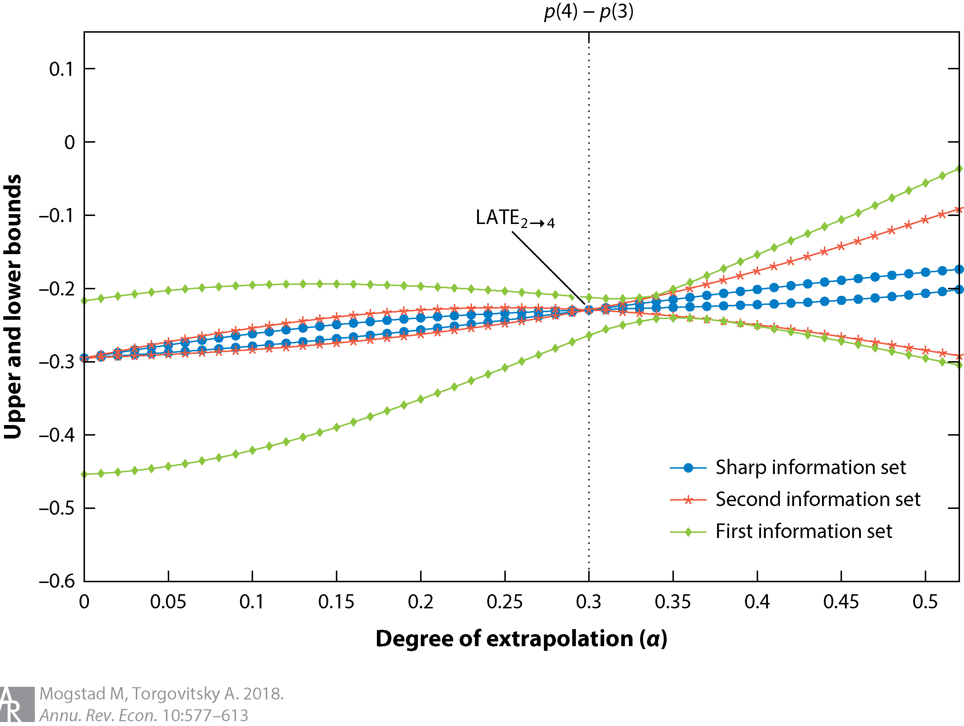
Computational Example: LATEs
Notes:
More assumptions = better bounds.

Slide 69

Notes:
From PGP’s website. Has limited takeup ultimately due to wide identified sets in a lot of cases, but still has a lot of potential.

Slide 70

Another example: OVB
What if your identification is threatened by omitted variables that you simply can’t control for?
Notes:
We don’t really have time to cover this in depth unless someone really wants it.

Slide 71

Another example: OVB
What if your identification is threatened by omitted variables that you simply can’t control for?
One possible approach (similar to partial identification) is to use bounds on the sensitivity of your results to including controls (Oster bounds)
Notes:
We don’t really have time to cover this in depth unless someone really wants it.

Slide 72

Another example: OVB
What if your identification is threatened by omitted variables that you simply can’t control for?
One possible approach (similar to partial identification) is to use bounds on the sensitivity of your results to including controls (Oster bounds)
Based on the formula for OVB
If we assume (1) selection on unobserved variables is equal to selection on observed variables and (2) under the null of no treatment effect.
Then we can calculate bounds for how much $β$ might move if we include additional unobserved variation.
By then comparing the magnitude of the bias to the size of the initial treatment effect estimate, one can infer how selection on unobserved variables must compare to selection on observed variables in order to fully explain the initial treatment effect estimate.
Notes:
Rough idea here. There are stata/r packages for this (psacalc)

Slide 73
A final approach: build out a structural model!
Discrete choice (static or dynamic)
$$\max_{{{\left\{a_{t}\right\}}^{∞}}_{t=1}}{𝔼[\sum_{t=1}^{∞}{β^{t−1}u\left(x_{t},a_{t},ε_{t};θ\right)} s.t. a_{t}∈𝕁}$$
Examples: plan choice (Einav et al., 2013; Brown and Jeon 2019; Ericson et al., 2021)
Demand estimation
$$Y_{im}=argmax_{j∈𝕁}X_{ijm}^{′}β_{im}−α_{im}P_{ijm}+ξ_{jm}+ε_{ijm}$$
Examples: endogenous prices (Tebaldi et al., 2023); Marone and Sabety (2022)
Discrete game models
$$\max_{z∈Z}{\prod_{k=1}^{p}{\left(u_{k\left(z\right)}−d_{k}\right)}}$$
Examples: Entry/exit, Hospital-insurer bargaining (Acuna et al., 2021)
Others: search, auctions, etc.
Notes:
*Some call this wonderland, others call it death by a thousand cuts* Some of the approaches we’ll cover in the next few minutes are semi-structural. Essentially, the more assumptions you make on your data, the closer you’ll get to point identification.
Einav et al: https://www.aeaweb.org/articles?id=10.1257/aer.103.1.178
Brown and Jeon: https://economics.smu.edu.sg/sites/economics.smu.edu.sg/files/economics/pdf/Seminar/2019/20191206.pdf
Ericson et al: https://academic.oup.com/ej/article-abstract/131/634/713/5848190
Tebaldi et al: https://onlinelibrary.wiley.com/doi/pdf/10.3982/ECTA17215?casa_token=oFnJIjb1_yIAAAAA:_wdz-1Elf_wHiWAGEvk0vxnf7V-Y42Db49FI4wWqBJKDtXRTx2kyd7VbdH4fPZ4dBiNUzbbSulMRkw
Marone and Sabety: https://www.aeaweb.org/articles?id=10.1257/aer.20201073
Acuna et al: https://link.springer.com/article/10.1007/s10729-021-09577-x

Slide 74

Are we out of the woods yet?

Slide 75
Appendix
Notes:
Cover this only if we have time

Slide 76
Hurdle Models
Notes:
Cover this only if we have time

Slide 77
A unique form of excess dispersion: Zeros
A common violation of Poisson assumptions is having too many 0s in data
Sometimes, you want a different model processes for 0/positive outcome
Notes:
Examples of different processes: have to decide first time whether to go, based on location, lack of relationship, uncertainty about cost, etc. After I go once, number of visits is more related to actual medical needs (and easier due to physician relationship, automatic appointments, etc.). This is an example of censored/corner solution data (Pr(Y=0) > 0)

Slide 78
A unique form of excess dispersion: Zeros
A common violation of Poisson assumptions is having too many 0s in data
Sometimes, you want a different model processes for 0/positive outcome
Can model these separately with a hurdle model, which has 2 steps:
Participation decision: whether number of visits will be positive or 0.
Amount decision: how many visits take place once hurdle is crossed?
Notes:
Examples of different processes: have to decide first time whether to go, based on location, lack of relationship, uncertainty about cost, etc. After I go once, number of visits is more related to actual medical needs (and easier due to physician relationship, automatic appointments, etc.)

Slide 79

Hurdle Models in Theory
Suppose we have data $s∈\{0,1\}$ on whether $y=0$ or $y>0$
Consider a latent variable $w^{∗} such that y={sw}^{∗}$
Notes:
Note that this means that anything could be true for the value of y when we don’t observe it

Slide 80

Hurdle Models in Theory
Suppose we have data $s∈\{0,1\}$ on whether $y=0$ or $y>0$
Consider a latent variable $w^{∗} such that y={sw}^{∗}$
We make a conditional independence assumption:
$D\left(w^{∗} | s,X\right)=D\left(w^{∗} | X\right)$ for some treatment effect $D\left(⋅\right)$
Essentially, mechanisms governing $s$ and $w^{∗}$ are independent
Can therefore estimate them separately!

Slide 81

Hurdle Models in Theory
Suppose we have data $s∈\{0,1\}$ on whether $y=0$ or $y>0$
Consider a latent variable $w^{∗} such that y={sw}^{∗}$
We make a conditional independence assumption:
$D\left(w^{∗} | s,X\right)=D\left(w^{∗} | X\right)$ for some treatment effect $D\left(⋅\right)$
Essentially, mechanisms governing $s$ and $w^{∗}$ are independent
Can therefore estimate them separately!
$𝔼\left[y | x\right]=\operatorname{Pr}\left(s=1\right)𝔼\left[w^{∗} | x\right]$
Participation decision
Amount decision

Slide 82

Hurdle Models in Practice
Step 1: Prediction of “hurdle jumping”
E.g., logit or probit, where outcome is 1$\{visits>0\}$
$$\operatorname{Pr}\left(Y_{i}=0 | W_{i}\right)=\frac{\exp\left(W_{i}\hat{γ}\right)}{1+\exp\left(W_{i}\hat{γ}\right)}=\hat{π_{i}}$$
Step 2: Model for number of occurrences given $y_{i}>0$
E.g., a zero-truncated Poisson model
$$\operatorname{Pr}\left(Y_{i}=j | Y_{i}>0,X\right)=\frac{\operatorname{Pr}\left(Y_{i}=j|X\right)}{\operatorname{Pr}\left(Y_{i}>0 | X\right)}=\frac{{\exp\left(Xβ\right)}^{j}e^{−Xβ}}{j!\left(1−e^{−Xβ}\right)}$$
Things to Note:
Two separate models
How to link $\hat{π}$ and “crossing the hurdle”?
Notes:
Notice that W and X have different variables and coefficients—not restricted to be the same. Equation for Poisson is same as pdf, except for bolded part which is 1-f(0) (rescales distribution). Pi is linked to hurdle based on data—hurdle package pins down exact number of 0s at those observed in data (so pi_overbar is a “moment” that matches the data

Slide 83
Is a Hurdle Model Appropriate?
Hurdle models are great if there really are two processes in your data
If the decisions driving one DGP are different from another
Applications to behavioral econ galore!
But hurdle models can’t help you if your problem isn’t a separate DGP:
Selection (we don’t observe data for some people for some reason)
Data are censored/error in measurement
Any reason the 0s in your data aren’t actually 0s
In these cases, a two-part model will be biased
These issues are addressed another way: a technique called Heckit
Notes:
E.g., differences in planned versus realized choice, insurance plan choice verus follow-up years, etc. Heckit is named after James Heckman. I’ll give a brief overview of Heckit but not its implementation—basically if you’re working with crummy data, you’re already losing a big chunk of the battle so best not to focus on this too much.

Slide 84

Heckit: A brief overview
Like hurdle models, Heckit models specify two equations:
Probability of an observed outcome $Pr⁡(y observed)$ (note: not probability that $y_{i}>0$)
Main regression, matching the moment $𝔼(y|x,y observed)$
Examples:
Are 0-visit people not going to a doctor, or do they not have access?
Smoking: are the 0s lies? Are non-smokers just price responsive?
Main setback: need to specify a selection equation
No longer assuming conditional independence across $s$ and $w^{∗}$
This requires you to be very confident in your DAG and your data
Generally, if you have the data to predict selection, selection isn’t a problem
Notes:
The main difference between heckit and hurdle is that hurdle deals with 0s in the actual outcome, while heckit deals with potential outcomes (e.g., the potential outcome is latent, so we stick a 0). So in the PCP example, the potential number of visits for some people isn’t observed because they don’t have access – that’s a selection problem (not someone who chose not to go to a doctor they had access to, that’s an actual outcome). The problem is that you have to specify a model predicting who didn’t have access—stronger identification issues.

Slide 85
Example: How can LTC care be expanded affordably?
Context: public subsidization of LTC in Spain (2007)
Universalized and funded access to LTC
One advantage: heterogeneously introduced across regions (identification!)

Slide 86
Example: How can LTC care be expanded affordably?
Context: public subsidization of LTC in Spain (2007)
Universalized and funded access to LTC
One advantage: heterogeneously introduced across regions (identification!)
Contribution: first assessment of causal effects of access to LTC
Outcomes: social/health-related needs, hospital costs
What do we think? Valid? Interesting?

Slide 87
Example: How can LTC care be expanded affordably?
Context: public subsidization of LTC in Spain (2007)
Universalized and funded access to LTC
One advantage: heterogeneously introduced across regions (identification!)
Contribution: first assessment of causal effects of access to LTC
Outcomes: social/health-related needs, hospital costs
What do we think? Valid? Interesting?
Data: Survey panel (2004-2013)
How useful is this? What would be better?

Slide 88
Example: How can LTC care be expanded affordably?
Context: public subsidization of LTC in Spain (2007)
Universalized and funded access to LTC
One advantage: heterogeneously introduced across regions (identification!)
Contribution: first assessment of causal effects of access to LTC
Outcomes: social/health-related needs, hospital costs
What do we think? Valid? Interesting?
Data: Survey panel (2004-2013)
How useful is this? What would be better?
Methods: What identifying assumption are they resting on?
Do they have a control group? Who?
Notes:
Resting on differences across regions – specifically variation in timing

Slide 89

Data: What story are we telling here?
Notes:
Thoughts on this figure?

Slide 90

Side Note: Figures
What is this?
Notes:
Don’t do this! What’s wrong with it? Does show shorter length of stay for the black lines? Does it show what we want? What they want is for you to look at time trend within the red/black groups (red LOS is going down, black is going up-ish)

Slide 91
Data: What story are we telling here?
Outcome variables:
Hospital admission (extensive margin)
Hospital utilization/length of stay (intensive margin)
Assumptions to check:
Is there a selection process that needs to be modeled?
Are we observing the zeros?
Notes:
Thoughts on this figure?

Slide 92

Empirical Strategy: Decision Stage
Decision stage is modeled as a difference-in-differences:
Subsidization meaningfully changes likelihood of admission
Notes:
What do we hypothesize about the coefficient alpha3 (captures the reform’s impact)

Slide 93

Empirical Strategy: Intensity Stage
Intensity stage is also modeled as a difference-in-differences:
Subsidization meaningfully changes total utilization
Notes:
Which hypothesis is more credible? Do you wish this had been done a different way?

Slide 94
Empirical Strategy: Intensity Stage
Intensity stage is also modeled as a difference-in-differences:
Subsidization meaningfully changes total utilization
Use IV (control function) to deal with endogeneity (with 6 instruments!):
Socialist party support + post interaction
Coverage of public home care prior to policy + post interaction
Proportion of women outside the labor market (why?)
Living in a rural area or not
Notes:
Which variable do they think is endogenous? What do you think about IV validity? Women outside labor market is indicative of providing informal care?

Slide 95

Results: IV First Stage
Notes:
What are the takeaways here?

Slide 96

Results: Hurdle Model
Notes:
Note – this ignores a lot of the DDDDDDD structure (we have different types of policies, different budgetary cuts, etc. But what’s the general takeaway here? What coefficient should we be looking at here? How should we interpret (the first column is marginal effects, the second and third are IRRs)

Slide 97
Policy Implications: Hospital Costs
Micro-simulation on how subsidization affected hospital costs:
Compute average cost/day for each admission
Estimate region-level # of beneficiaries of caregiving allowances and home care beneficiaries (who did the policy affect?)
Apply hurdle model coefficients to (1) to obtain change in LoS
Change in LoS * Affected # of people = Savings from program
Notes:
Do you see any problems with this? Obviously doesn’t take into account the cost to the taxpayer, and assumes homogeneous treatment effects. Still, pretty handy.

Slide 98

Policy Implications: Hospital Costs
Micro-simulation on how subsidization affected hospital costs:
Compute average cost/day for each admission
Estimate region-level # of beneficiaries of caregiving allowances and home care beneficiaries (who did the policy affect?)
Apply hurdle model coefficients to (1) to obtain change in LoS
Change in LoS * Affected # of people = Savings from program
Notes:
Maybe consider changing units here? Add in euro sign, idk. It’s a lot to look at. Also some lines telling my eyes where totals/cells are would be helpful.

Slide 99
Mini Referee Report
What do you think about this paper? Any concerns? Anything clever?
Notes:
Poor writing quality, bad figures (?) I don’t like imputation of data (wave 4 was missing public home care data)

Slide 100
Multinomial Choice Logit
Notes:
Also called discrete choice models

Slide 101
Multinomial Choice Logit: When Choices Matter (More)
What if our data is on choices between N different options?
E.g., type of insurance coverage, treatment (surgery, medication, etc.)
This is actually more similar to logit than you think!
Notes:
Choice of specialty: choosing to be a surgeon vs. in IM or PCP. We can think about logit as a binary choice – did the patient choose treatment or not? Now we’re extending that, in data speak, to N choices instead of 2.

Slide 102

Multinomial Choice Logit: When Choices Matter (More)
What if our data is on choices between N different options?
E.g., type of insurance coverage, treatment (surgery, medication, etc.)
This is actually more similar to logit than you think!
Example: an elderly patient arrives w/ aortic stenosis. Are they treated with:
Open-heart valve replacement surgery
Transcatheter valve replacement surgery
Simple observation
$y_{i}$ is the choice of treatment $i$, while $\vec{x}$might include:
Patient age
Risk factors
Symptoms
Physician characteristics
Notes:
In this example, pretend that these are the only 3 possible choices.

Slide 103

What makes this setting unique?
This data and setting doesn’t look like others we have encountered
The outcome variable is unordered
Now, we have $i∈\{0,1,2\}, where$
$0=$watch and wait
$1=$ open-heart surgery
$2=$transcatheter surgery
How can we use retrospective data to assess choices?
Notes:
How would order surgical choices? If these were RHS variables could just have a lot of dummies but we want one single regression evaluating choice across all alternatives on LHS.

Slide 104

What makes this setting unique?
This data and setting doesn’t look like others we have encountered
The outcome variable is unordered
Now, we have $i∈\{0,1,2\}, where$
$0=$watch and wait
$1=$ open-heart surgery
$2=$transcatheter surgery
How can we use retrospective data to assess choices?
Assume that observed choices are utility-maximizing
That is, if $y_{i}=1$, then we assume $u_{i}\left(1\right)≥u_{i}\left(0\right)$ and $u_{i}\left(1\right)≥u_{i}(2)$
We want a model that links $u_{i}(x_{1},x_{2},…, x_{N})$ to $y_{i}$
Look familiar?
Notes:
We assume a “latent utility-maximizing framework”. Now we have a new link function (utility)! The difference here is that it’s not a known distribution, but rather we are interested in the characteristics of that link function. Talk about ordinal/relative goals on next slide.

Slide 105

Multinomial Logit: Setup
In order to assess this, we need to assign a benchmark outcome
That is, we compare $u(y_{2})$ and $u(y_{1})$ to $u\left(y_{0}\right)$
Why do we need to do this?
Notes:
We need a benchmark because utility is an ordinal concept – it only has meaning as a comparison across states. (40 utils doesn’t get me anywhere).

Slide 106

Multinomial Logit: Setup
In order to assess this, we need to assign a benchmark outcome
That is, we compare $u(y_{2})$ and $u(y_{1})$ to $u\left(y_{0}\right)$
Why do we need to do this?
Then, we model $y_{ji},$the utility of choice $j$ compared to choice $i$ as:
$$y_{ji}=α_{j}+β_{j1}X_{1ji}+β_{j2}X_{2ji}+ …+β_{jn}X_{nji}+ε_{ji}$$
Do you see the logit forming here? How do we get to binary choice (logit)?
Notes:
What does it mean if y_ji > 0 verus y_ji < 0? Think about the outside option as set to 0. What is the outcome now? Utility → but can easily be converted into choice as a piecewise link function

Slide 107

Multinomial Logit: Setup
In order to assess this, we need to assign a benchmark outcome
That is, we compare $u(y_{2})$ and $u(y_{1})$ to $u\left(y_{0}\right)$
Why do we need to do this?
Then, we model $y_{ji},$the utility of choice $j$ compared to choice $i$ as:
$$y_{ji}=α_{j}+β_{j1}X_{1ji}+β_{j2}X_{2ji}+ …+β_{jn}X_{nji}+ε_{ji}$$
Do you see the logit forming here? How do we get to binary choice (logit)?
In reality, we are estimating $J−1$ logits!
What does $α_{j}$ represent?
Notes:
alpha_j represents level differences in utility across options. Note that the notation x_ji helps convey that demographics can vary across choices or individuals (kind of an abuse of notation). Generally, your covariates will not vary in both dimensions at once.

Slide 108

Multinomial Logit: Intuition
Notes:
Here there are 3 choices and 2 determinants of utility (plus level shifts). Regression lines identify the boundaries here. Can you see why we don’t need three regressions, but only 2?

Slide 109

Multinomial Logit: Estimation
How can we estimate these altogether?
Assumption 1: Logit specification. Assume models are linear in log-odds:
$$η_{ij}= log\left(\frac{π_{ij}}{π_{iJ}}\right)=α_{j}+x_{i}^{′}β_{j} for j∈\{1, 2, …, J−1\}$$
Assumption 2: Normalize outside option. If we assume $η_{iJ}=0:$
We can construct choice probabilities by exponentiating the system
$$π_{ij}=\exp\left(η_{ij}\right)/\sum_{k=1}{\exp\left(η_{ik}\right) }$$
Notes:
Exponentiating leads to \pi_ij=\pi_iJ*exp(eta_ij). Do this on the board in a system of 3 equations. After exponentiating, sum up all probabilities to show formula for pi_i3, and then plug that in for the others

Slide 110

Multinomial Logit: Estimation
From choice probabilities we can recover likelihood function
$$\operatorname{Pr}\left(Y_{i1}=y_{i1},Y_{i2}=y_{i2},…, Y_{iJ}=y_{iJ}\right)=\left(\begin{aligned}n_{i} \\ y_{i1},…y_{iJ}\end{aligned}\right)π_{i1}^{y_{i1}}…π_{iJ}^{y_{iJ}}$$
Note that the MLE depends on the parameters $α_{j}, β_{j}$ through each $π_{ij}$
So we get $J−1$ sets of regression parameters!
What are the interpretations here?
Notes:
Interpretations are all relative to outside option

Slide 111

Multinomial Logit: Interpretation
Estimating gives us coefficients on each of the $J−1$ logistic regressions
Just as in logit, we can exponentiate coefficients to get odds ratios
We can also compute marginal effects and predicted probabilities
Some options for interpretation:
Relative log-odds: the main coefficients (don’t use)
Relative risk ratios: exponentiated coefficients (multiplicative effect)
Marginal effects: similar to logit marginal effects
Notes:
A note on relative risk ratios: odds ratios are relative and hence depend on baseline levels (e.g., a 1.5 times increase from 1 is 1.5 but from 100 is 150). This plays a critical role in the economic significance of your results.
Evaluating a complicated model in econometric analysis becomes more and more about story-telling – the more complicated your model is, the more certain your assumptions are wrong. How useful is your model?

Slide 112

Multinomial Logit: Interpretation
Estimating gives us coefficients on each of the $J−1$ logistic regressions
Just as in logit, we can exponentiate coefficients to get odds ratios
We can also compute marginal effects and predicted probabilities
Some options for interpretation:
Relative log-odds: the main coefficients (don’t use)
Relative risk ratios: exponentiated coefficients (multiplicative effect)
Marginal effects: similar to logit marginal effects
We can also check the accuracy of our predictions (model performance)
Note: since there are multiple regressions, overall accuracy matters
as well as any ways in which the model mis-predicts
Data visualization is key!
Notes:
A note on relative risk ratios: odds ratios are relative and hence depend on baseline levels (e.g., a 1.5 times increase from 1 is 1.5 but from 100 is 150). This plays a critical role in the economic significance of your results.
Evaluating a complicated model in econometric analysis becomes more and more about story-telling – the more complicated your model is, the more certain your assumptions are wrong. How useful is your model?

Slide 113

A quick note: multinomial probit versus logit
Here, we are generally focusing on MNL, but you could also run a probit
Just a different assumption about $ε_{ji}$
Some pros and cons:
Logit works well when $J$ is large (think 5 or more)
However, logit assumes $Corr\left(ε_{j1} ,ε_{j2}\right)=0$, while probit can handle arbitrary correlations.
This implies choice probabilities satisfy independence of irrelevant alternatives (IIA)
The odds of choosing A over B must not depend on whether $C$ is an option
This makes sense in some settings but not in others
There are other options: conditional logit, nested logit, etc.
Notes:
If you have a small choice set and care about the correlations in choice, probit may work better.
Example of IIA: if you have car or bus and then add a bike lane, maybe you should pull equally from both (go from 50% and 50% to 40%, 40%, and 20%). But if you have a car and a red bus, and then add a blue bus, you wouldn’t expect this.

Slide 114
Example: How do physicians choose specialties?
Context: Is there an over (under) supply of specialists (general practitioners)?
Notes:
This is an area of research I’m particularly interested in these days

Slide 115
Example: How do physicians choose specialties?
Context: Is there an over (under) supply of specialists (general practitioners)?
Contribution: What (non-pecuniary) factors drive that choice?
What do we think? Valid? Interesting?
What’s the main mechanism? What’s the hypothesis/hypotheses?
Notes:
This is an area of research I’m particularly interested in these days

Slide 116
Example: How do physicians choose specialties?
Context: Is there an over (under) supply of specialists (general practitioners)?
Contribution: What (non-pecuniary) factors drive that choice?
What do we think? Valid? Interesting?
What’s the main mechanism? What’s the hypothesis/hypotheses?
Novel method: choice experiment
Survey + stated preferences between two options
Data: Australian junior doctors who have not yet chosen their specialty.
Advantages: choices are presented exogenously (RCT), each person answers multiple questions (let’s you use a person fixed-effect)
Notes:
This is an area of research I’m particularly interested in these days

Slide 117
Example: How do physicians choose specialties?
Context: Is there an over (under) supply of specialists (general practitioners)?
Contribution: What (non-pecuniary) factors drive that choice?
What do we think? Valid? Interesting?
What’s the main mechanism? What’s the hypothesis/hypotheses?
Novel method: choice experiment
Survey + stated preferences between two options
Data: Australian junior doctors who have not yet chosen their specialty.
Advantages: choices are presented exogenously (RCT), each person answers multiple questions (let’s you use a person fixed-effect)
Assumptions: what features are important for their results?
Notes:
Need to have survey be honest, actually well thought out reponses, etc. Also external valididty (we’re in Australia and only looking at hospital non-generalists; those who are “on the border” between specialists and GPs who have worked without committing one way or another for about 3 yearS)

Slide 118

Choice Experiment
Notes:
Some of my concerns – experimental design (i.e. choice between specialty A and B instead of between surgery and generalist?). I thought the authors did well addressing these concerns openly.

Slide 119

Choice Experiments
Notes:
Each observation in the data is a choice between two of these hypothetical worlds. Given enough choices, can back out importance of each parameter (think of a decision tree) while accounting for individual-level idiosycracy. Of course: 2916 possible choices! For the pilot survey and then for the main survey, we generated a fractional factorial of 36 binary choice sets containing 72 alternatives (4 versions; 9 choices per doctor).

Slide 120

Results: What do MDs Care About?
Notes:
How do we interpret these results? Recall that (2) is like (1) + individual FE. Rather than calculate marginal effects, the coefficients are reported as is (how useful is this) and converted to MWTP -- MWTP for an attribute is the ratio of the coefficient estimate for that attribute and the coefficient estimate for the earnings attribute.

Slide 121

Policy Implications: Simulating Choices
Notes:
Simulation comes from MABEL data for differences between GP and specialists (top half). Then the simulation allows parameters to be matched to WTP (expressed in earnings) and counterfactual simulations. Calibrated base case uses actual Australia market shares.

Slide 122
Mini Referee Report
What do you think about this paper? Any concerns? Anything clever?
Notes:
Some of my concerns – experimental design (i.e. choice between specialty A and B instead of between surgery and generalist?). I thought the authors did well addressing these concerns openly. I really like the simulation here – that’s a big perk of these discrete choice models (plug for structural estimation, which we will do next time)

Slide 123

Conclusion: Limited Dependent Variables
Binary: LPM, Logit, Probit
Ordered: Poisson, Negative Binomial
Selection: Hurdle Models, Heckit
Choices: Multinomial Logit models
Notes:
Focusing only on these three for today

